Slide 1
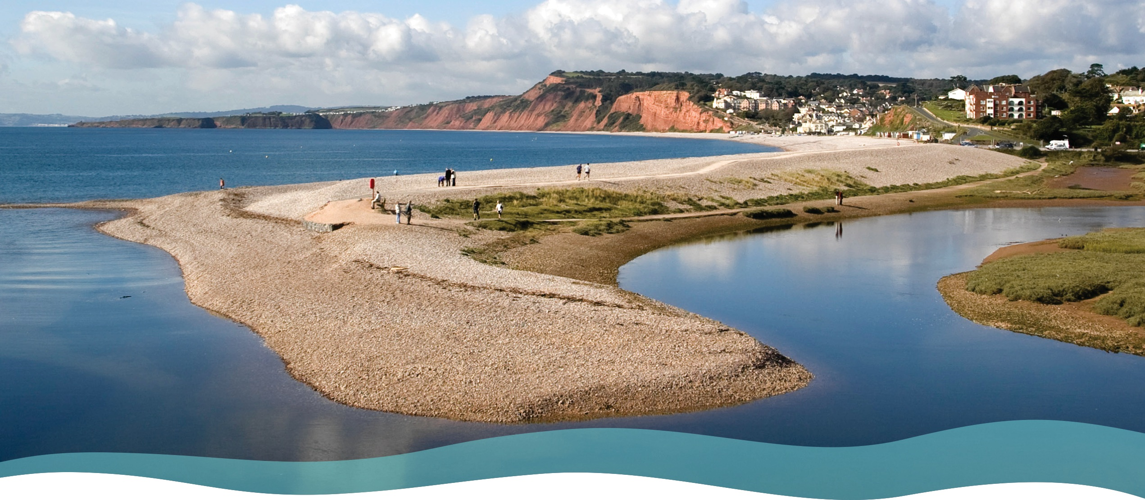

Sustainable coastal management
Lower Otter, Devon
Teacher’s notes and student activities

Slide 2
Sustainable coastal management
Sustainable coastal management is a key part of the popular A level coasts topic.
Students need to understand the options for managing the coast, and the meaning of sustainable coastal management within the overall context of Integrated Coastal Zone Management (ICZM) and Shoreline Management Plans (SMPs).
The fluvial and marine processes of erosion, transport and deposition contribute to the inputs and outputs of sediment in coastal sediment cells. Human activities have an impact on these processes and affect the overall sediment budget of a section of coast.
The Lower River Otter and its estuary provide an excellent example of sustainable coastal management based on managed realignment. The scheme is providing a “model” of managed realignment of an estuary which may be adopted elsewhere. The coast is part of the South Devon and Dorset Coastal Advisory Group (SDADCAG) Shoreline Management Plan that covers over 300 km from Dorset to Plymouth.

Slide 3
Teaching resources
There are two sets of resources:
A Powerpoint presentation providing students with an illustrated study of the Lower Otter restoration project and sustainable coastal management. The presentation begins with an overview of sustainable coastal management and the case study and then focuses on the specific management issues and options, and the managed realignment solution.
This Powerpoint presentation providing Teachers’ Notes including a selection of activities and references (slides 4-10).

Slide 4
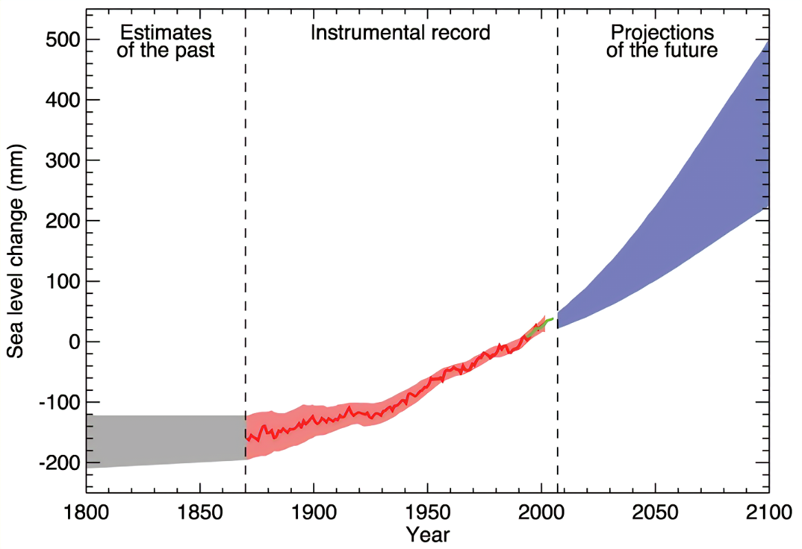
Activity: Predicted sea level changes
Study the graph: Describe the changes in sea level from:
  i) 1870 to 2008 and (ii) 2008 to 2100
How has technology provided more accurate measurements of sea level since the 1990s?
Explain why sea levels are projected to rise in the next 100 years.
Explain how higher sea levels are likely to affect low lying coasts and river estuaries like the Lower Otter.
Key to graph:
Grey – 1800-1870 Sea level estimates from various data
Red – 1870 -2008 Red line = mean Sea level reconstructed from tide gauges with red shading the range of variations. Green line is sea level observed from satellite altimetry
Blue – 2008 -2100 Range of model sea level projections
Image source: https://aambpublicoceanservice.blob.core.windows.net/oceanserviceprod/education/pd/climate/factsheets/issea.pdf

Slide 5
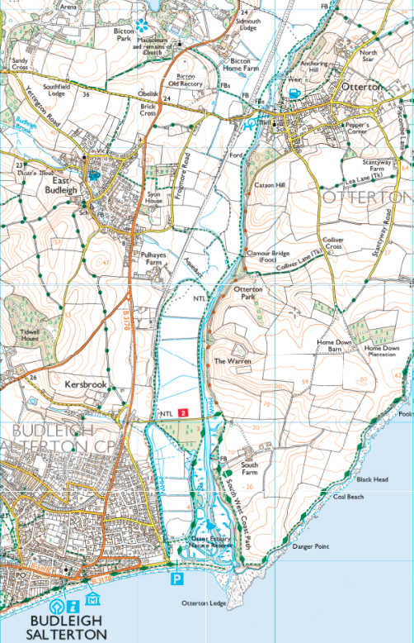
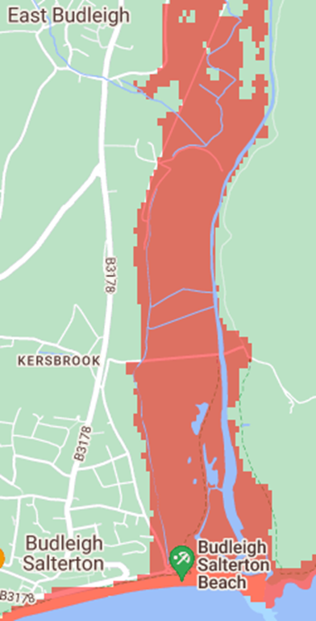
Activity: Need for sustainable management. Impacts of flooding and sea level rise
The OS Map extract shows the Lower Otter and the Coast. The image shows projected flooding resulting from sea level rise by the year 2100 with no human intervention.
Using map evidence and the student PowerPoint, describe and explain which land uses and human activities are at risk from increased river and coastal flooding in the Lower Otter.
N
1 KM
Image source: Climate Central | Land projected to be below annual flood level in 2100
Alternative source: Budleigh Salterton news: news and sport in Budleigh - East Devon News

Slide 6
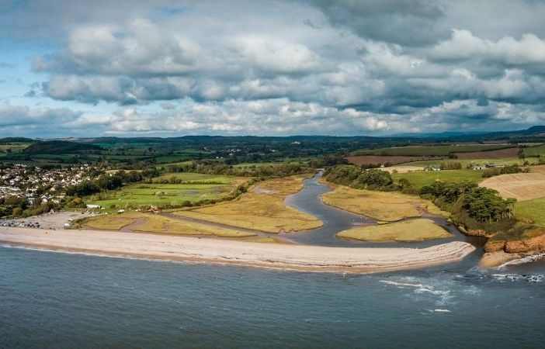
Activity: Sediment sources and sinks
On a sketch of this photo, identify three fluvial and three marine sources of sediments in this sediment cell, and three areas where sediments are being deposited.
Explain how human activities are likely to affect the movement and deposition of sediments in this sediment cell.

Slide 7
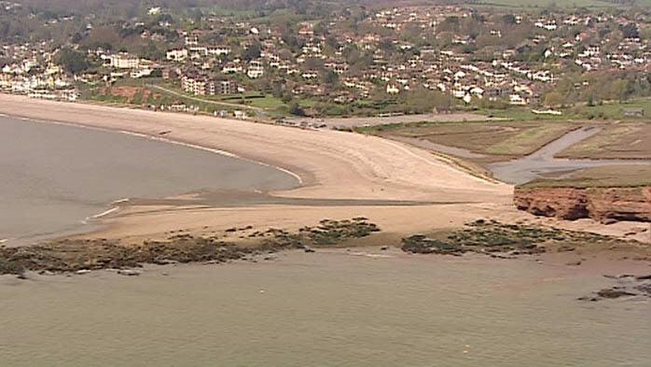
Activity: Processes in the sediment cell
The photograph shows the mouth of the River Otter. Slide 7 in the student PowerPoint shows details of the sediment movements along this section of coast.
Explain how littoral drift (longshore drift) has contributed to the development of the pebble ridge (spit) across the mouth of the Otter estuary.
Explain the processes which cause some river sediments to be naturally deposited within the estuary forming mudflats and salt marshes.
How would hard engineering solutions such as cliff protection, sea walls and embankments affect the natural movements of sediment in this area?

Slide 8
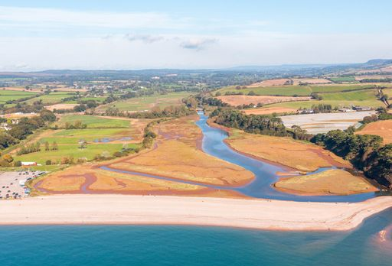
Activity: Management options
Three management options were considered for the Lower Otter:
No active intervention: the “do nothing option”
Hold the line: maintain existing coastal defences, including maintaining the 200-year-old embankments protecting the reclaimed farmland
Managed realignment: allow the shoreline to adjust by breaching the embankments and allowing the water to re-occupying reclaimed land
Referring to the photo and using evidence from the student PowerPoint, explain the advantages or disadvantages of each of the three options for the Lower Otter.

Slide 9
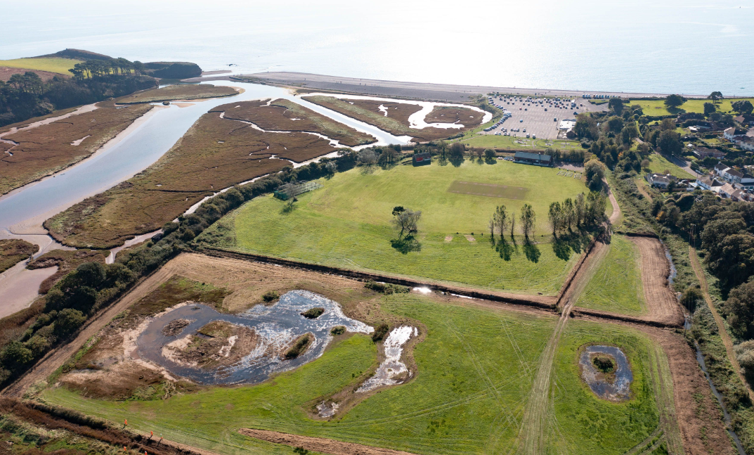
Activity: Sustainable coastal management
The preferred option for sustainable coastal management of the Lower Otter was ‘managed realignment’.
Using the information in the student PowerPoint, assess why the project is considered to be both environmentally and economically sustainable. Refer to flood protection, benefits to wildlife, economic sustainability and improved amenity in your answer.
Lower Otter before management work started

Slide 10
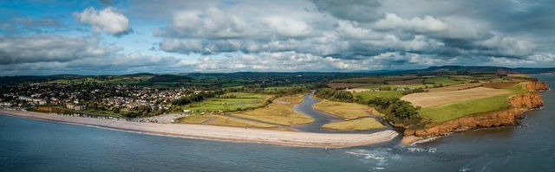
Activity: Cost - Benefit analysis
A detailed cost/benefit analysis was carried out for the Lower Otter managed realignment plan. The total cost of the managed realignment scheme is £ 12 million
Referring to slide 19 in the student PowerPoint, create a table to show the main costs and benefits of the scheme.
Assess why the benefits of the scheme are considered to outweigh the costs.
Photo credit: KOR Communications

Slide 11
Suggestions for further student activities
Referring to slides 11, 17, 19 and 20 in the student PowerPoint, assess the importance for wildlife, and the natural sediment cycle of replacing reclaimed floodplain farmland with wetland areas such as mudflats and saltmarshes.
Research one other example of managed realignment in the UK and summarise the key aspects of the project. Describe the similarities and differences with the Lower Otter Restoration Project. A possible example is the Selsey scheme. Medmerry Managed Realignment Scheme – Mackley Civil Engineering
Geography NEA
There are several opportunities for individual research enquiries focusing on sustainable coastal management. The field studies council website provides some useful examples. Research could include the environmental impact of coastal and river flooding, an environmental impact assessment, questionnaires on proposed schemes seeking views of local people and stakeholders, and studies of sediment movements along a beach.
https://www.field-studies-council.org/resources/16-18-geography/coasts/coastal-management/method/

Slide 12
References
The Lower Otter Restoration project (LORP) has an extensive range of useful information, images and maps at: http://www.lowerotterrestorationproject.co.uk/pacco.html
Summary of the Lower Otter plan: http://www.lowerotterrestorationproject.co.uk/plansummary.html
A useful perspective from a local online newspaper can be found at: https://eastdevonnews.co.uk/2021/01/06/multi-million-pound-plan-to-restore-natural-otter-estuary-flood-plains-at-budleigh-salterton-are-approved-east-devon/
Detailed flood risk guidance for river catchments and estuaries can be found here: https://www.devon.gov.uk/floodriskmanagement/document/nfm-guidance-for-devon/
A useful article on sediment budges and sediment cells can be found at: https://www.sciencedirect.com/topics/earth-and-planetary-sciences/sediment-budget
For suggestions to support NEA enquiries, see the Field Studies Council website at: https://www.field-studies-council.org/resources/16-18-geography/coasts/coastal-management/
A detailed geological overview of the Straight Point to Otterton Ledge sediment cell, with both a map and explanatory commentary can be found at: https://www.scopac.org.uk/scopac_sedimentdb/stott/stott.htm#5.1

Slide 13
For more information visit www.pacco-interreg.com

