Slide 1
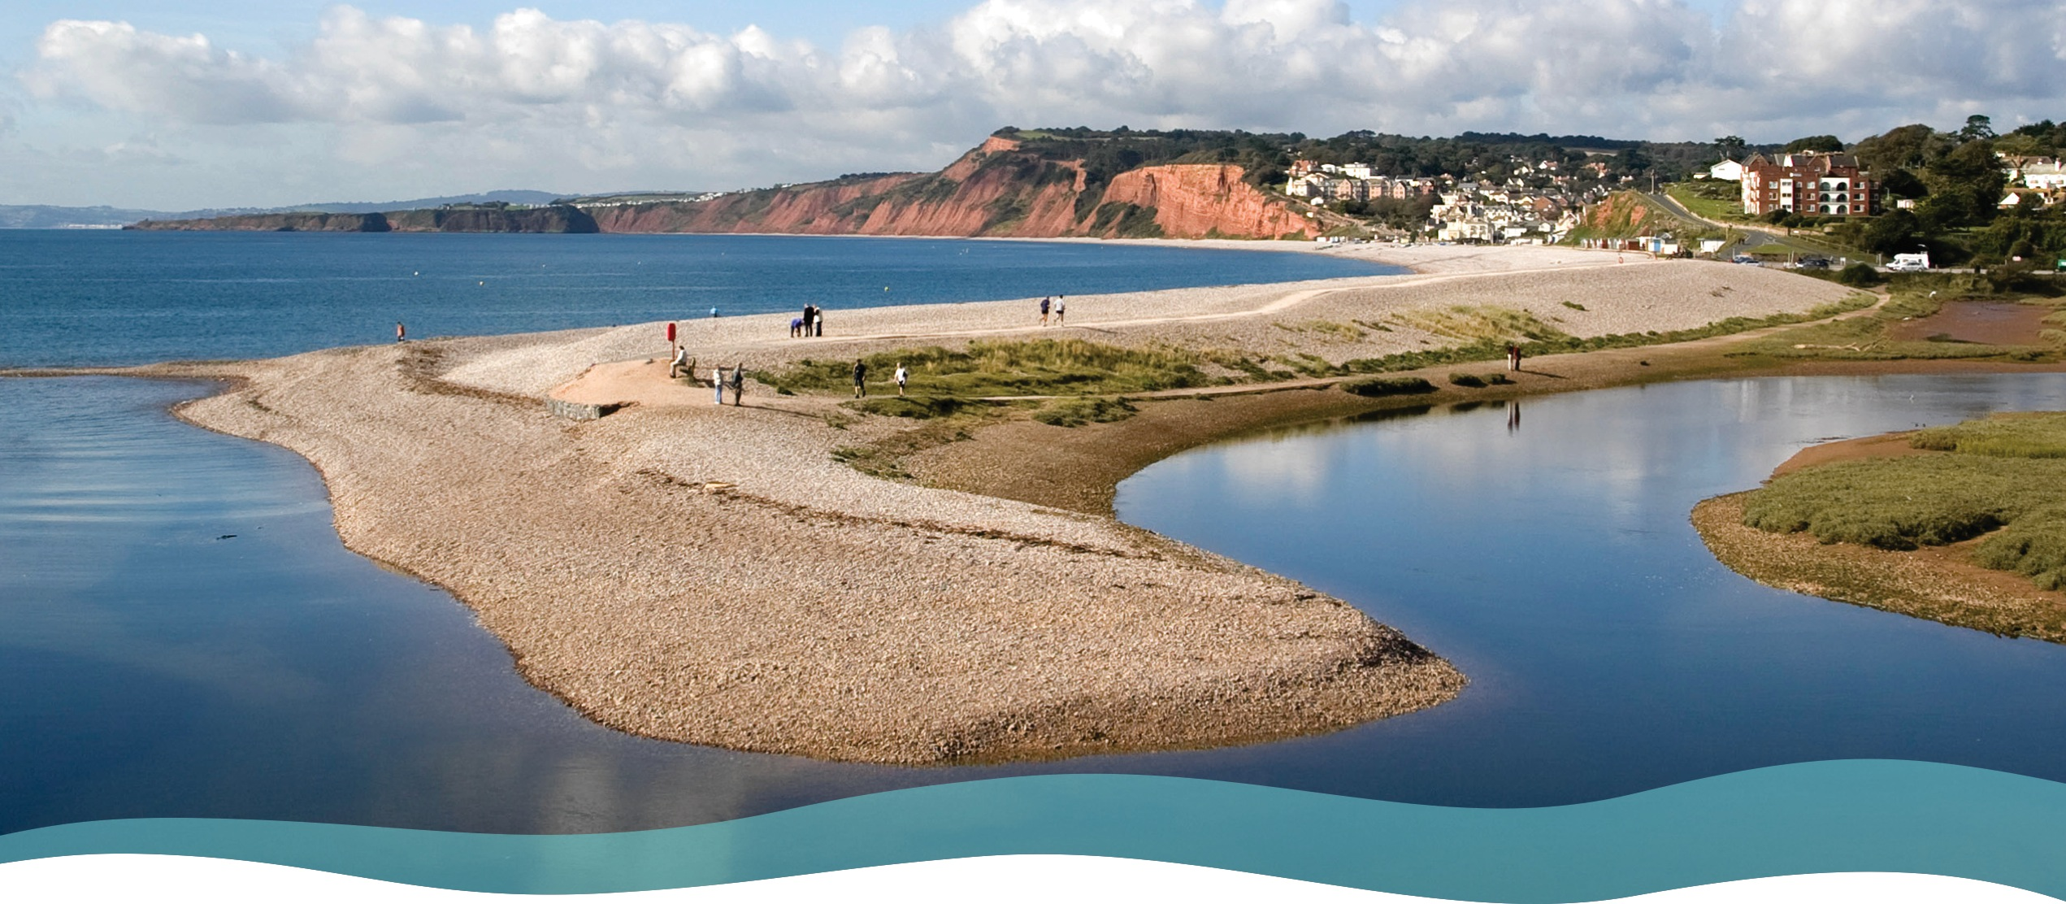

Sustainable coastal management
Case Study: Lower Otter Restoration Project, Devon

Slide 2
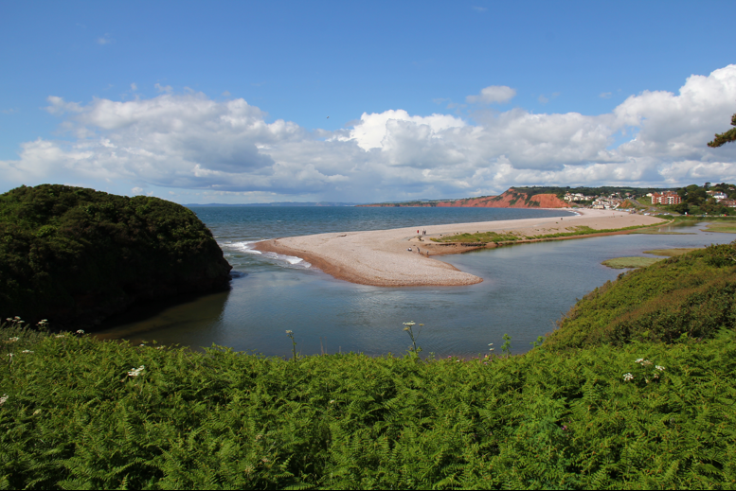
Sustainable coastal management
Coastal management has 3 aims:
Protecting the coastline from wave attack and erosion during high tides and severe storms.
Protecting the coastline from flooding by sea water, especially during storms and high tides.
Conserving fragile coastal ecosystems including saltmarshes, mudflats, sand and shingle spits and sand dunes.
The Lower Otter Restoration Project aims to manage the Lower Otter as sustainably as possible by enhancing natural wildlife habitats and restoring natural processes.
Where the River Otter meets the sea at Budleigh Salterton
Image credit: John Davidson

Slide 3
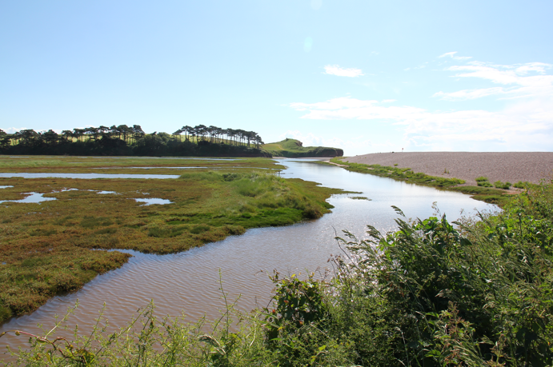
Why do coasts need to be managed sustainably?
Sustainable coastal management aims to ensure:
Environmental sustainability: conserving coastal ecosystems and maintaining the “look” of the coastline.
Economic sustainability: ensuring coastal communities thrive. This includes protecting people, property and businesses from coastal erosion and flooding, and making sure that the benefits of management strategies outweigh the costs.
Social sustainability: ensuring that the lives and livelihoods of coastal communities are not impacted by coastal erosion or flooding.
River Otter salt marsh ecosystem at Budleigh Salterton Image credit: John Davidson

Slide 4
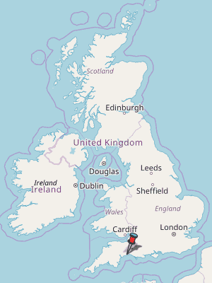
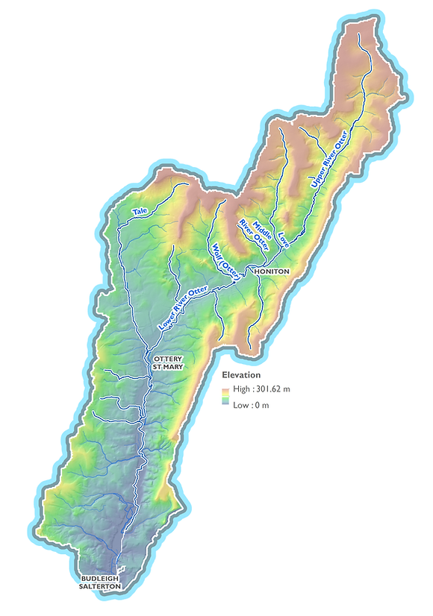
Case study area: River Otter and South Devon coast
The River Otter flows for 44 km (27 miles) from the Blackdown Hills (Somerset) to the English Channel at Budleigh Salterton, with a catchment area of 25000 hectares.
The river flows through a rural landscape of mainly cattle, sheep and dairy farms. 50% of the land use is improved grassland, 28% arable and 5% urban. The remaining 17% includes woodland, heathland, saltmarsh and freshwater.
The river valley is includes important ecosystems , areas of protected landscape. The estuary is part of the UNESCO World Heritage Jurassic Coast.
N
https://www.riverotterfisheriesassociation.org/maps-of-the-river-otter-catchment
https://www.freecountrymaps.com/map/towns/great_britain/117061762/

Slide 5
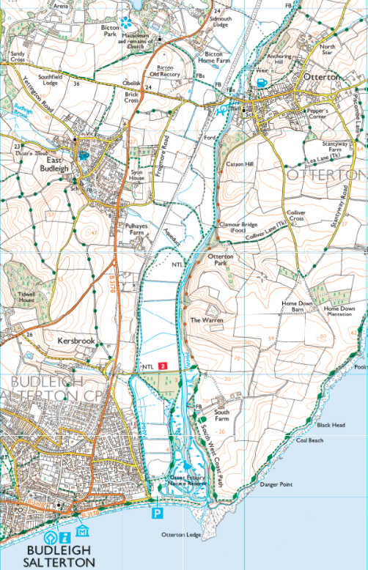
Case study area: The Lower Otter and East Devon coast
River Otter
N
The 1:25,000 map extract shows the Lower Otter from Otterton and East Budleigh to the sea.
The River Otter flows from north to south on the map.
It has been disconnected from it’s original floodplain by artificial embankments constructed around 200 years ago. It now occupies an artificially straightened channel, pushed to the east of the valley.
There are many straight (artificial) drainage ditches on the original floodplain, making farming possible.
Settlements include Budleigh Salterton and two villages.
A pebble ridge (spit) stretches across the mouth of the river providing some protection from storms.
Public footpaths and the South West Coast Path are shown.
The River Otter is part of a local coastal sediment cell.
Floodplain
Gently
rolling
hills
Drainage
ditch
Pebble
ridge
Embankment
I km

Slide 6
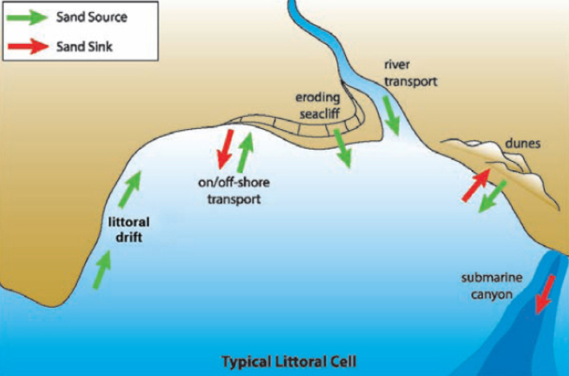
What is a sediment cell?
A coastal sediment cell (littoral cell) is a section of coast with a balance of sediment inputs (sources) and sediment outputs (sinks).
Sources of sediments include eroding cliffs, eroding beaches and sand dunes, and sediments derived from rivers.
Longshore drift (littoral drift) moves beach sediments along the coast within the sediment cell.
Sediment sinks include sand and pebble spits, sand dunes, offshore bars, and deep sea deposits.
An increase in inputs into the sediment cell is balanced, by more coastal transport and outputs to sinks.
Human activities affect sediment cells by disrupting sources of sediment or interfering with sediment transport.
Image credit: Beach Nourishment and Sediment Budgets - Through The Sandglass (typepad.com)

Slide 7
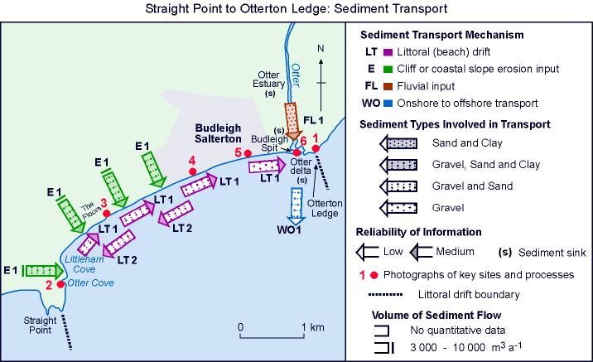
Sediment transport in the coastal sediment cell – Straight Point to Otterton Ledge
The sandspit at Budleigh has been formed from littoral (beach) drift from west to east, with most material coming from cliff erosion.
Deposition on the inland side of the spit derives from river (fluvial) deposits.
The Otter delta visible at low tide is formed from both littoral drift and river deposits.
Sediments are moved offshore by destructive storm waves and currents.
Natural sediment movements have been affected by embankments along the River Otter.
Image source: MMIV © SCOPAC Sediment Transport Study
Sediment Transport Sources, Pathways and Sinks (scopac.org.uk)

Slide 8
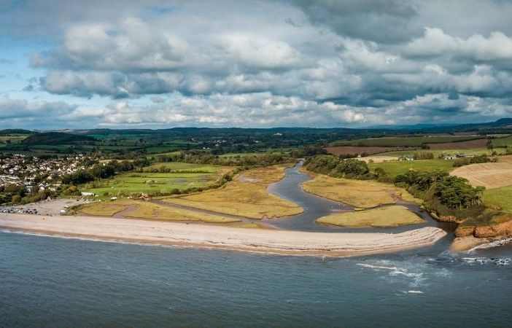
The Lower Otter and the local sediment cell
Fluvial sediments are deposited in the river estuary to form mudflats and salt marsh
The River Otter is an important source of fluvial sediments
The incoming tide can add sediments to mudflats especially when fresh water meets salt water
Sediments movements along the coast by longshore drift (littoral drift) and from offshore have created a pebble ridge across the river estuary
The river and outgoing tides carry suspended sediment and bedload into the sea forming a delta visible at low tide
Image source: KOR Communications

Slide 9
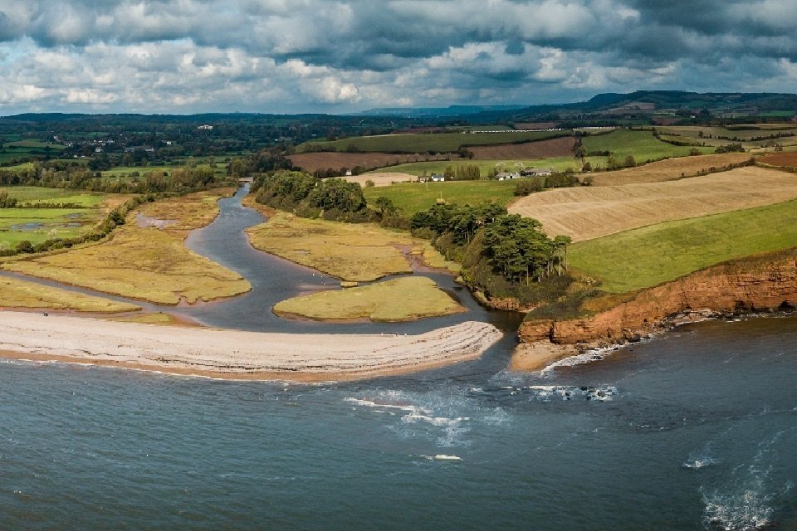
Sustainable management - the issues
Embankments were created 200 years ago when part of the flood plain was reclaimed for farmland and the river was straightened.
The embankments are no longer cost effective. They are at risk of being breached during a major flood or storm.
Sea levels are predicted to rise by up to a metre in the next 100 years, increasing flood risks.
Climate change will increase frequency and severity of storms, with river and seawater flooding threatening agricultural land, local roads, footpaths and trees and hedges.
The Lower Otter Estuary provides important habitats for a wide variety of breeding and wintering bird species.
Artificial embankments and land reclamation have affected the natural movements of sediment in the sediment cell.
Embankments
Credit: KOR Communications

Slide 10
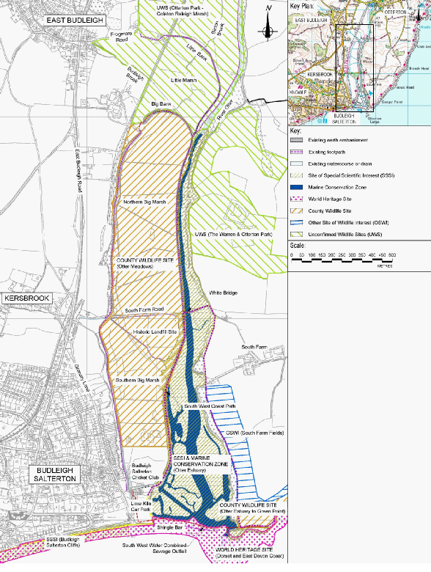
Sustainable management - the protected areas
The Otter Estuary Nature Reserve is a Site of Special Scientific Interest (SSSI) consisting of important ecosystems including saltmarsh and mudflats.
The coast at the mouth of the estuary is part of the Jurassic Coast World Heritage site and a protected wildlife refuge.
The South West coast path crosses the estuary.

Slide 11
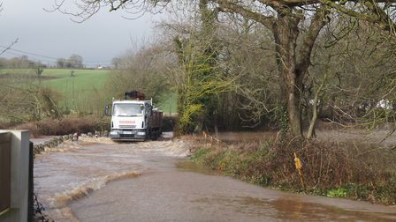
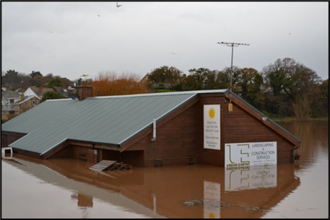
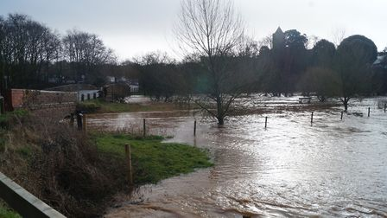
Sustainable management – the economic impact of more frequent floods
Flooding in 2018 and 2021 caused road closures when the River Otter burst its banks near Otterton.
Flood water inundated farmland. The embankments prevented flood water draining away at low tide!
Budleigh Salterton Cricket Club grounds and pavilion, and local footpaths were flooded.
Climate change and rising sea levels are likely to increase the frequency and size of floods.
Rising sea levels will also increase risk of flooding.
https://www.exmouthjournal.co.uk/news/warning-to-motorists-as-roads-severely-flooded-near-exmouth-5780342

Slide 12
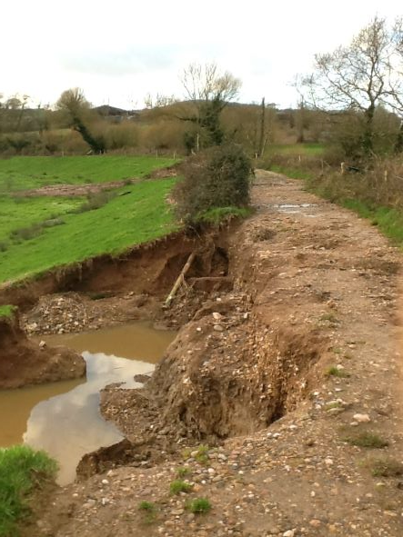
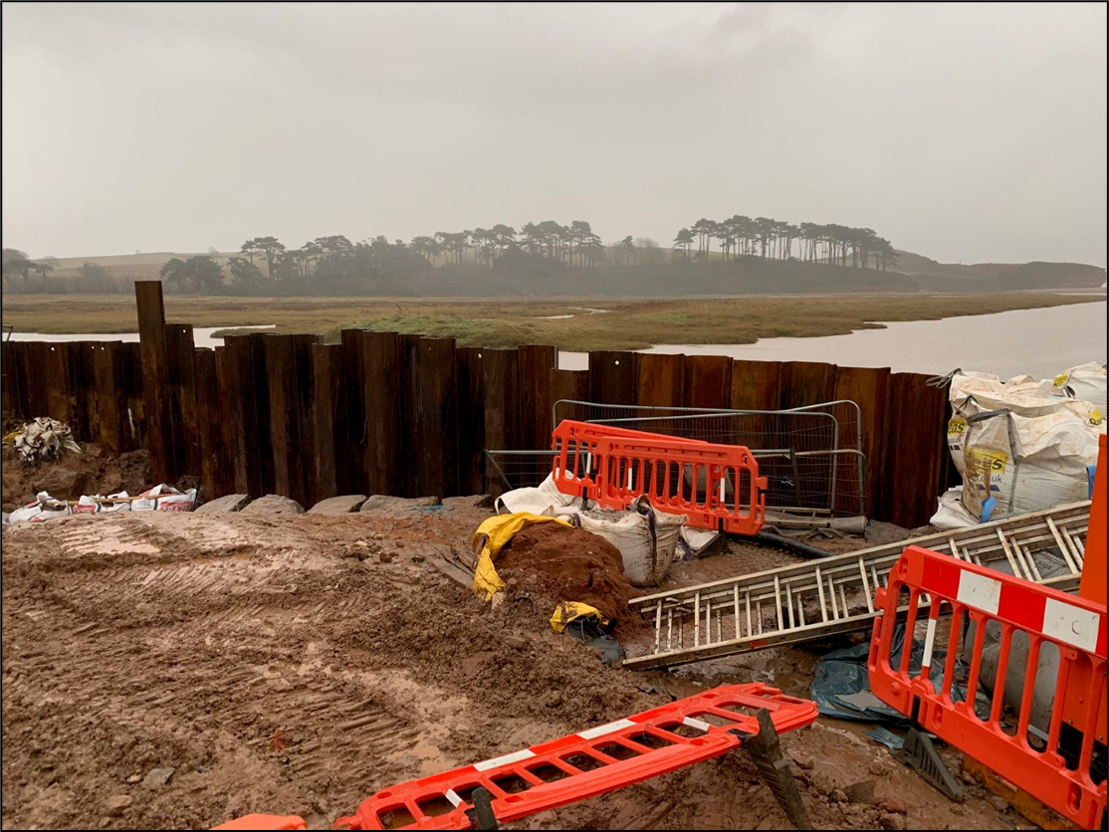
Sustainable management – need to address the erosion of embankments and repair costs
Floods in March 2018 washed part of Big Bank away. More damage occurred in 2021 floods. Expensive repairs were needed.
Future embankment damage and breaching is inevitable.
This is a strong argument for adopting a more sustainable form of coastal and flood management.

Slide 13
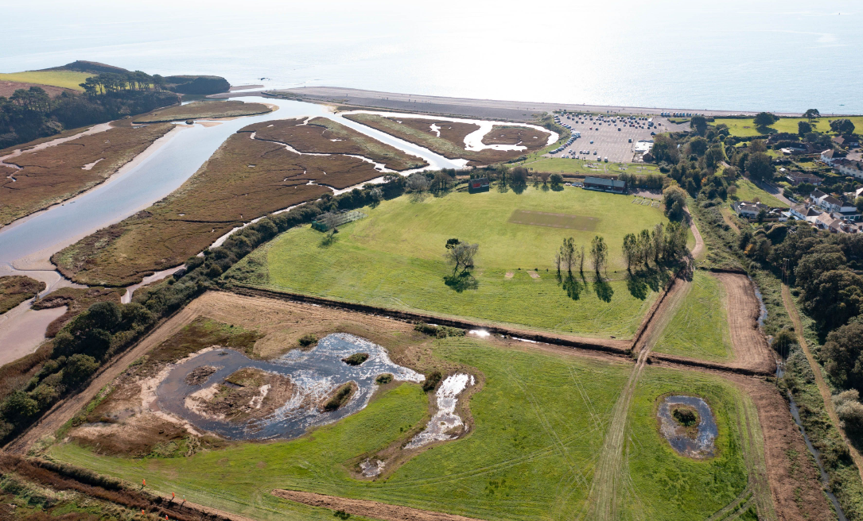
The need for a sustainable solution
This photo looks south towards the English Channel. The outskirts of Budleigh Salterton are in the top right and the cricket club in the top centre.
The embankments (marked by a line of trees and hedges) separate the present floodplain from reclaimed land.
To the left, the river meets the sea forming an estuary with mudflats and saltmarsh.
To the right, the land has been drained and improved for farming.
The embankments are no longer fit for purpose. Climate change means that a long-term sustainable solution is needed to manage this stretch of coastline and the Lower Otter floodplain.
Human made embankments
Credit: KOR Communications

Slide 14
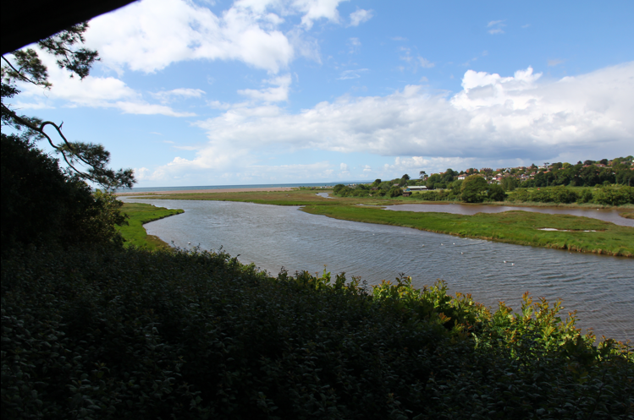
Lower Otter possible management options
No active intervention: the “do nothing” option. Costs of managing floods, damage and disruption will be continue to be high.
Hold the line: maintain existing coastal defences. The embankments will need expensive rebuilding and floods will still occur.
Advance the line: build new coastal defences on the seaward side. A very expensive option which would damage the environment.
Managed realignment: allow the shoreline to adjust by re-occupying reclaimed land and help restore the natural sediment balance.
Photo credit: John Davidson

Slide 15
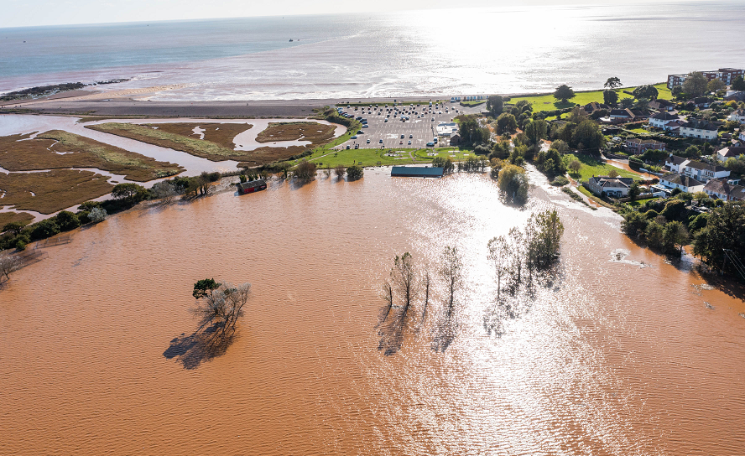
Sustainable management - managed realignment
In 2012, the landowner Clinton Devon Estates and a broad range of stakeholders decided to tackle the long-term challenges associated with climate change.
The social and economic implications of three options (‘Do Nothing’, ‘Hold the Line’ and ‘Managed realignment’) were considered from 2012 to 2015.
In 2015, the decision was made to adopt the managed realignment option:
Managed realignment is less costly than building new defences.
‘Do nothing’ would create uncertainty and anxiety for local people who would simply have to wait for the embankments to fail.
Managed realignment can safeguard and improve public access and enhance wildlife habitats.
Lower Otter during a flood, October 2021

Slide 16
Managed realignment of the Lower Otter – summary
Controlled breaching of the old embankments to restore the floodplain of the River Otter.
The farmland and former Budleigh Salterton cricket ground will be allowed to flood at high tide. The land will gradually become important mudflats and saltmarsh for birdlife.
The Budleigh Salterton cricket ground will be relocated elsewhere, away from flood risk.
The total cost is estimated to be £12m. £8.5m will come from the European Interreg France (Channel) England Programme. Other funding will come from the Environment Agency, DEFRA and the landowner, Clinton Devon Estates.
Credit: KOR Communications

Slide 17
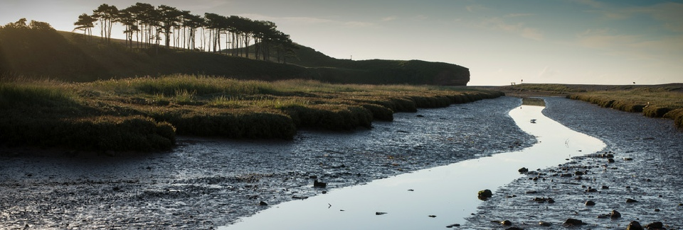
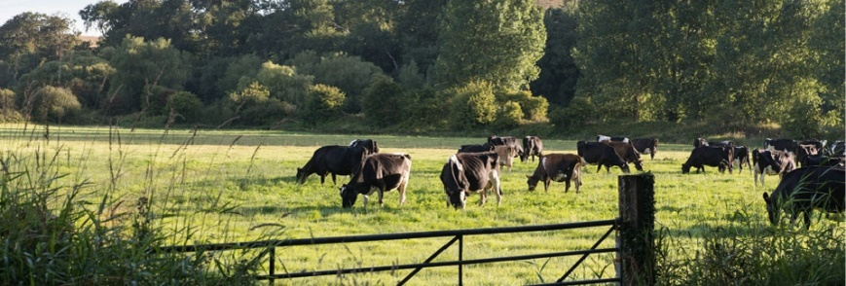
Managed realignment – detailed plan
Stabilising and capping a disused refuse tip on the reclaimed flood plain to protect it from erosion and remove contamination risks.
Providing new education and interpretation facilities.
Working with nature to increase the area of rare inter-tidal habitats with significant biodiversity benefits for aquatic life and birds.
Working with tenant farmers to adjust existing land use, allowing livelihoods to be secured, water quality to improve and biodiversity to increase.
Enabling natural sediment movements and deposition.
Breaching the embankments, enabling the river to reconnect with its floodplain and flood and drain naturally.
Building a new footbridge to spanning the embankment breach and maintaining and secure existing public footpaths including the nationally important South West Coast Path.
Securing vehicle access for local residents and businesses by raising a section of road.
Working with Budleigh Salterton Cricket Club to relocate the ground on a more sustainable site on higher ground above flood level.

Slide 18
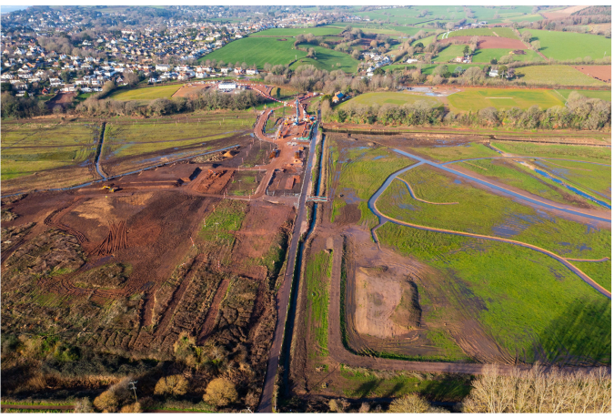
Managed realignment – the timeline
2021
Clearance of vegetation
Construction of new bridge foundations, road embankments and footpath raising
2022
Completion and surfacing of roads, bridges and footpaths
Diversion of services (water, electricity, sewage)
Removal of cricket club
2023
Completion of old landfill cover
Controlled breaching of embankments
Landscaping

Slide 19
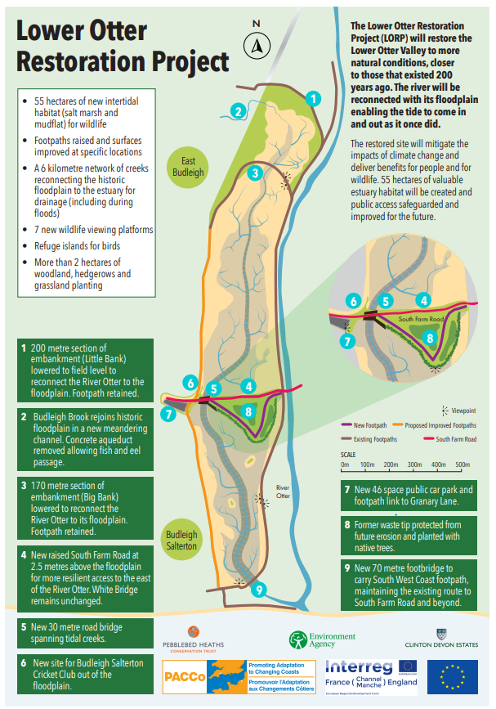
Managed realignment – actions
The map shows some of the actions and works that form part of the realignment project.
The Lower Otter floodplain will be restored allowing daily tidal inundation.
River flooding (due to more extreme future rainfall events) is accommodated to prevent it ponding-up behind embankments.
Bridges, roads and footpaths are raised to protect them from flooding.
Benefits to wildlife by the creation of intertidal habitats.
No artificial restrictions to the transport and deposition of marine and fluvial sediments.

Slide 20
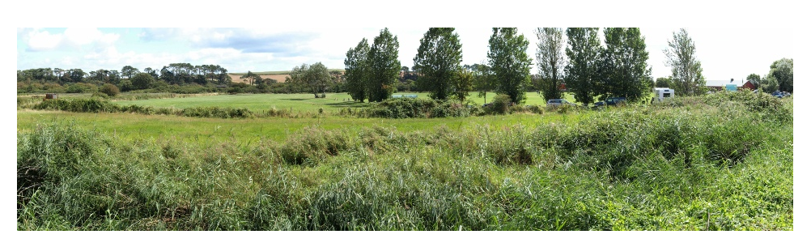
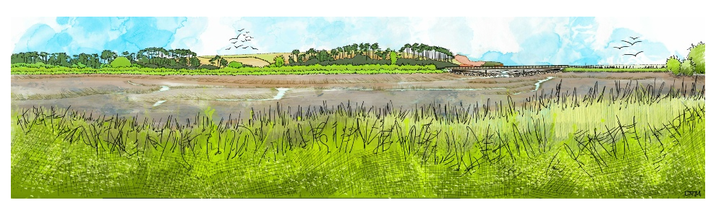
Managed realignment – the vision
The photograph is a view of the River Otter floodplain looking towards the south-east before managed realignment work began.
The artist’s sketch below visualises the view of the restored coastal wetland in 2038 (summer) showing mudflats, saltmarsh and a new footbridge carrying the South West Coast Path over the breach in the embankment.
The restored the floodplain will restore the natural processes that operated until around 1800 including sediment movements and stores, and enhance wildlife habitats.

Slide 21
Conclusion: sustainable management
Environmental sustainability:
Creation of natural habitats (mudflats, saltmarsh, reedbeds) will increase biodiversity and nesting/over-wintering grounds for birds.
The restoration of natural sediment transport and deposition will help maintain the dynamic equilibrium of the local sediment cell.
Sustainable management of the floodplain will increase natural resilience to the impacts of climate change (rising sea levels, increased storminess and more intense rainfall events).
Economic and social sustainability:
Raising roads, bridges and footpaths will increased the resilience of human activities to river and coastal flooding and reduce negative economic impacts.
Relocation of Budleigh Salterton cricket club to non-flood prone location will provide social and economic benefits.
The increased amenity value and enhanced access should attract more tourism from birders in winter outside the summer tourist season, boosting the local economy.
Overall conclusion: the managed realignment will help ensure that business and infrastructure will be protected from flooding by the managed realignment works, and will restoring natural processes and wildlife habitats.

Slide 22
For more information visit www.pacco-interreg.com

