Slide 1
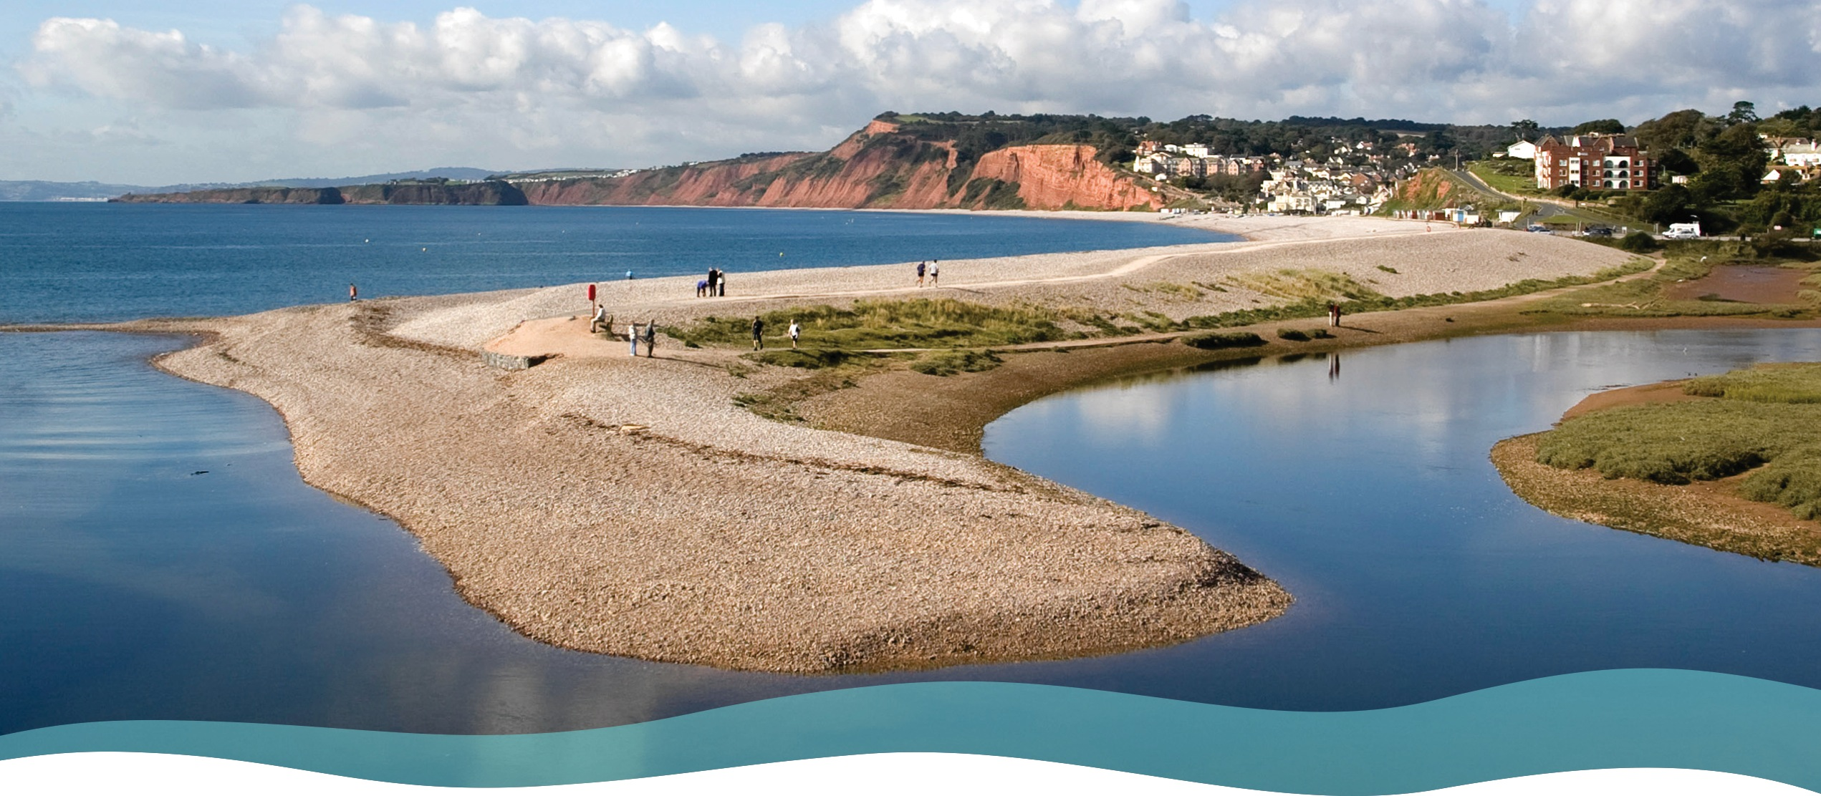

Landscape change
Lower Otter, Devon

Slide 2
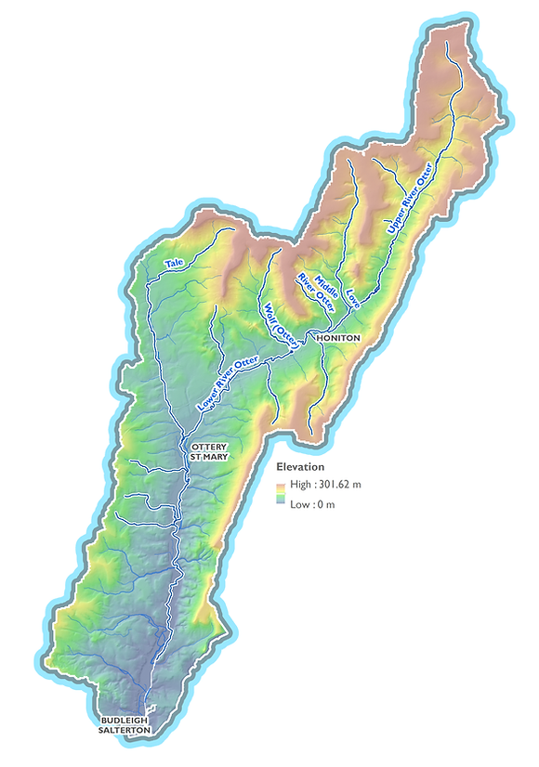
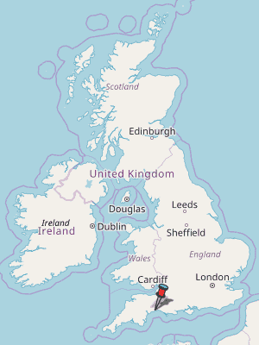
The River Otter, South Devon
The River Otter is a small river located in east Devon.
From its source in the Blackdown Hills, the river flows 44km (27 miles) south to discharge into the English Channel at Budleigh Salterton.
The river flows through a rural farming landscape, with mostly small cattle, sheep and dairy farms.
There are many smaller tributaries which promote rapid runoff after rainfall events. The river rises and falls very quickly.
Much of the Lower Otter valley is flat and low-lying. Flooding is common following extreme rainfall events.
Once extinct, the River Otter is England’s only river with a breeding population of beavers.
N
Approx. scale
2 km
https://www.riverotterfisheriesassociation.org/maps-of-the-river-otter-catchment

Slide 3
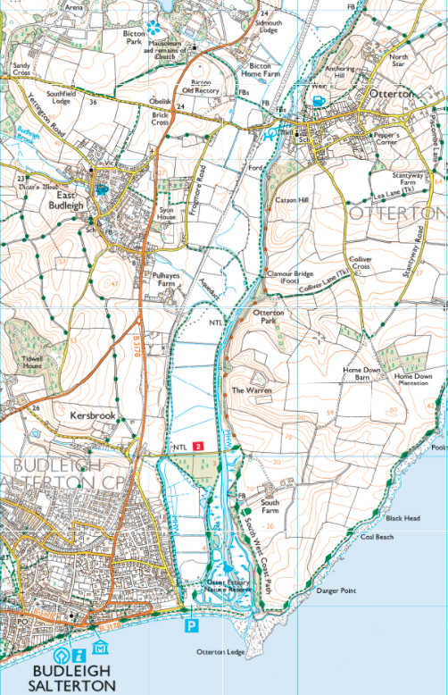
The Lower Otter – OS 1:25,000 map extract
River Otter
N
This is a 1:25,000 map extract of the Lower Otter. Notice the following:
The River Otter flows from north to south across a wide, flat floodplain.
There are many straight (artificial) drainage ditches on the river’s floodplain, enabling the land to be used for farming.
The land either side of the valley is quite high and gently rolling.
There are several settlements in the area including the town of Budleigh Salterton.
There is a pebble ridge stretching across the mouth of the river.
The river estuary is a Nature Reserve and the South West Coast Path runs across the valley.
Floodplain
Gently
rolling
hills
Drainage
ditch
Pebble
ridge
Embankment
I km

Slide 4
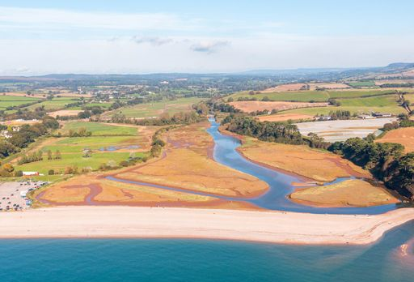
What is ‘landscape’?
‘Landscape’ can be defined as an area of land viewed at one time from one place. It can include landforms, flora, fauna and human elements such as roads and settlements.
This photo shows the Lower Otter river in East Devon.
The river is flowing in a southerly direction to join the English Channel near the seaside town of Budleigh Salterton.
Notice that the river is flowing through a gently rolling agricultural landscape with fields and hedges. Can you see any other signs of human activity?

Slide 5
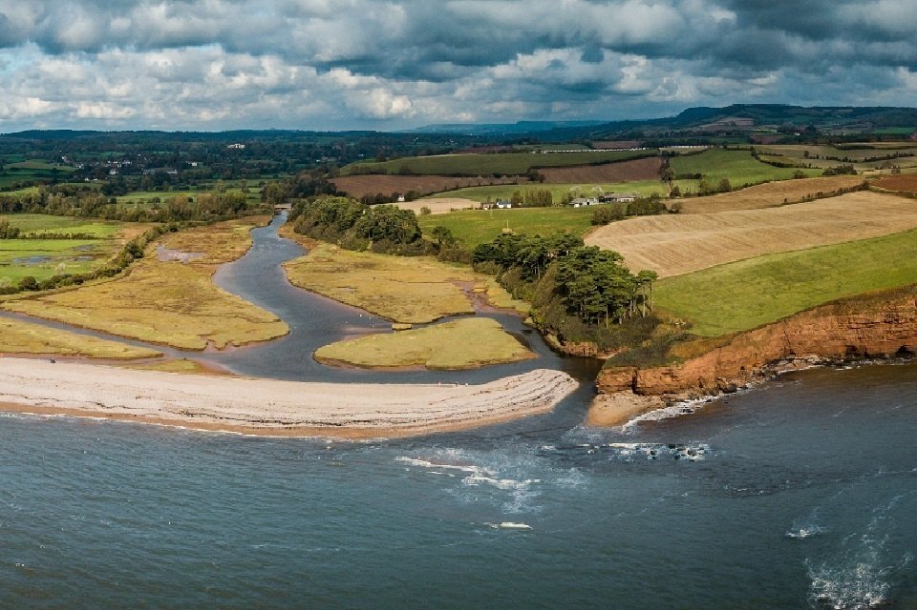
What causes landscape change?
The landscape of the Lower Otter is constantly changing due to physical and human factors.
Notice that the sea has formed a huge pebble ridge stretching across the river estuary. To the east, it has eroded the red sandstone rocks to form steep cliffs and caves.
River processes have eroded the river’s channel and deposited sediment across its floodplain.
The weather and climate affects the power of the sea and the amount of water flowing into the rivers.
People determine how the landscape is used and what it looks like, for example, farming, woodland, transport and settlement.
Credit: KOR Communications

Slide 6
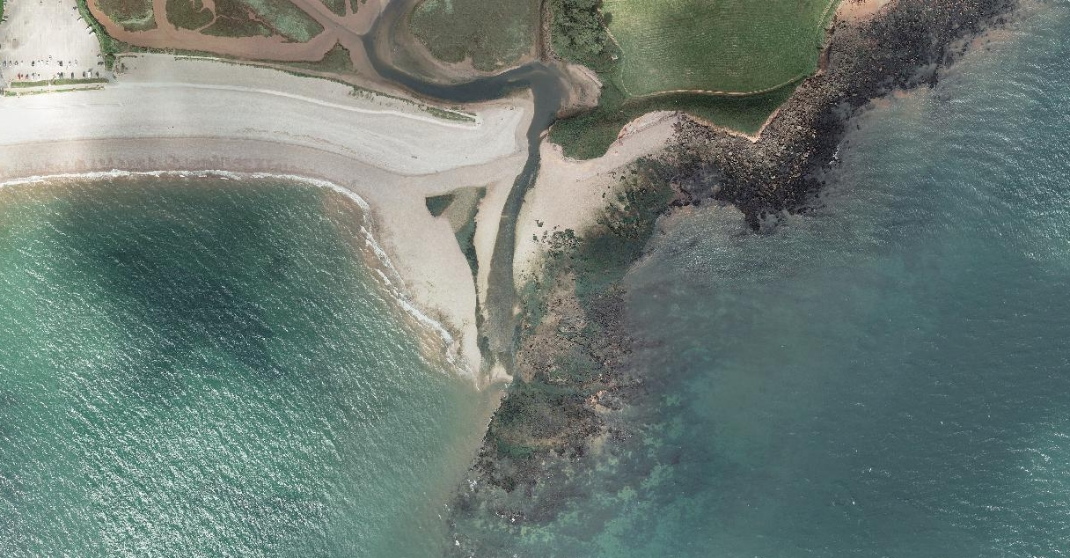
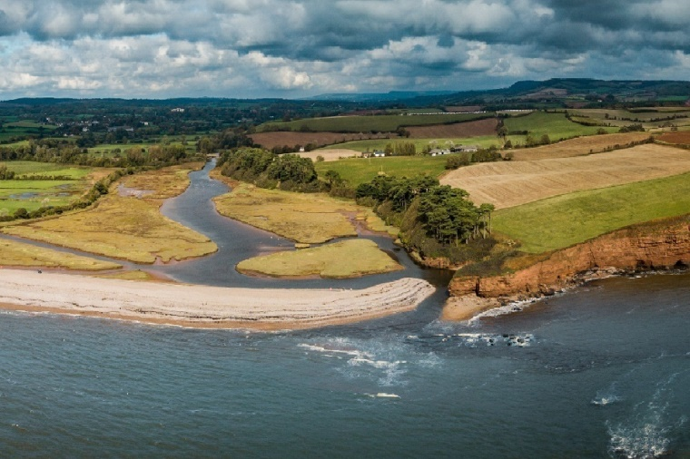
Landscape change – the sea
River Otter
Cliffs
Pebble ridge - bar
Look closely at the two photos.
The top photo is a vertical aerial photo of the River Otter estuary. Compare this view to the one shown below, an oblique aerial photo.
Locate the River Otter, the pebble ridge (called a bar) and the cliffs
The top photo was taken at low tide exposing the rocky wave-cut platform at the foot of the cliffs. The lower photo was taken at high tide.
Notice that at low tide the pebble ridge also extends further out to sea.
Notice that the vertical aerial photo gives no indication of height . . . everything appears to be flat!
Rocky wave-cut platform

Slide 7
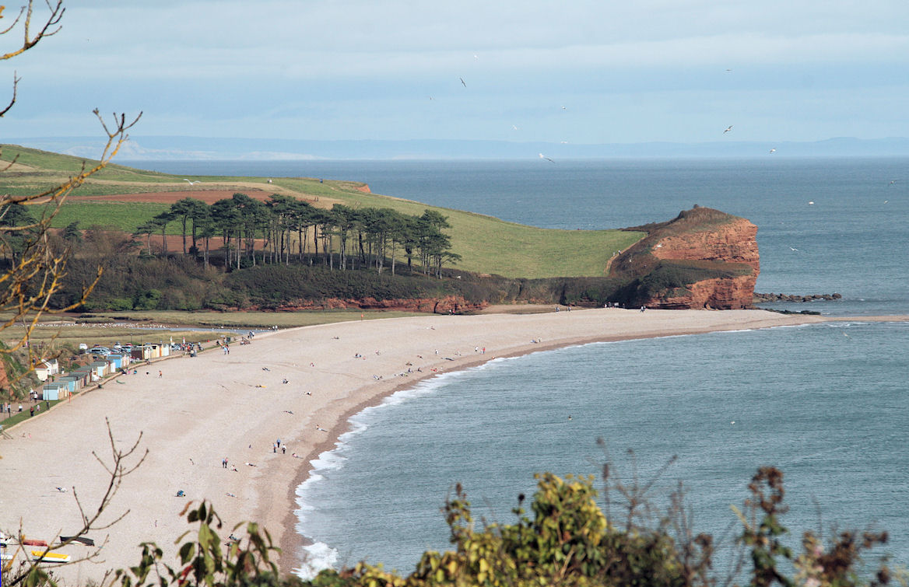
Landscape change – the sea
The pebble bar that extends across the River Otter estuary at Budleigh Salterton is the result of river and coastal processes.
Natural growth of the river bar across the Otter estuary began in the mid-1400s.
Since the Middle Ages, rivers across the UK (including the Otter) began silting up and channels became shallower. Silt accumulated in the Otter estuary adding material to the bar.
The dominant (prevailing) SW winds drive waves towards the coast from this direction, transporting sediment from west to east across the estuary and forming the bar.
Storms have pushed sediment up onto the beach from the seabed adding to its height and extent.
Sediment transfer
https://wessexcoastgeology.soton.ac.uk/jpg-Budleigh-Salterton/11BST-View-Otterton-Ledge-from-Cliff.jpg

Slide 8
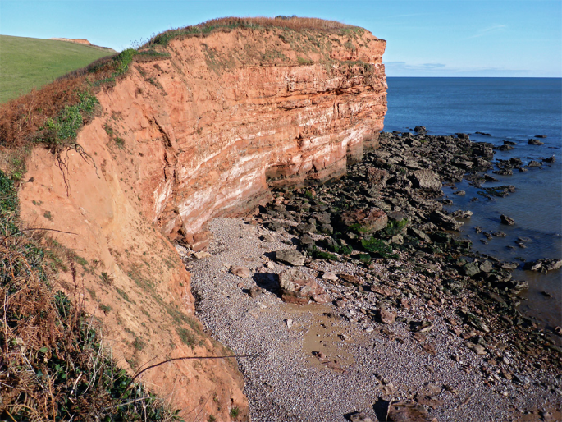
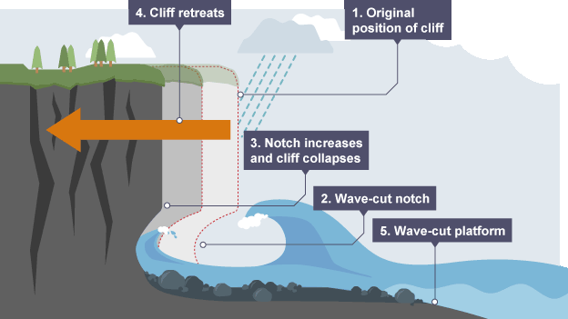
Landscape change – the sea
The cliffs and wave-cut platform are formed by coastal erosion.
The sandstone cliffs are weakened by rainwater and the action of frost
Breaking waves erode a notch at the base of the cliff
As the notch become bigger, the overhanging cliff collapses causing the cliff-line to retreat
As the cliff retreats, a rocky wave-cut platform is left behind
https://teleskola.mt/coastal-processes-3-cliff-retreat-and-wave-cut-platform/

Slide 9
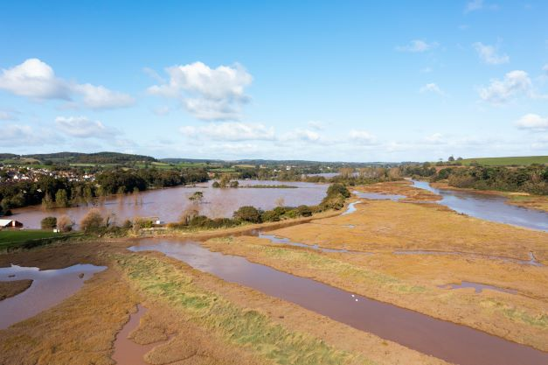
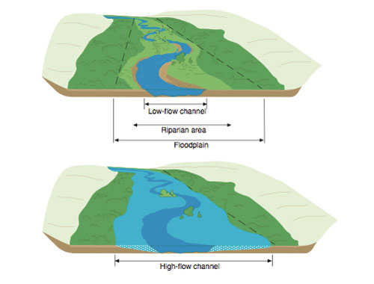
Landscape change – the river
Under these conditions, water spills over the banks to form a huge shallow lake. Sediment (alluvium) is deposited and, after many years, a wide and flat floodplain is formed.
Flooding is a common occurrence in the Lower Otter. This photo shows flooding in March 2018 following a period of heavy rain.
http://hotcore.info/kareff-05079.html

Slide 10
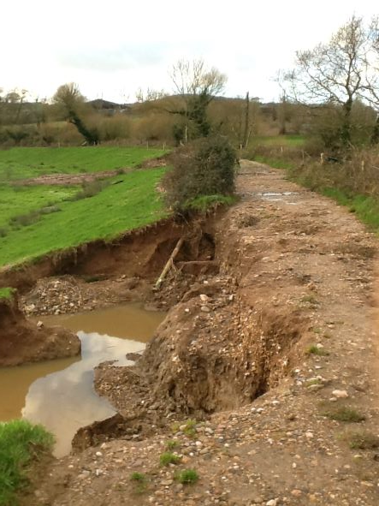
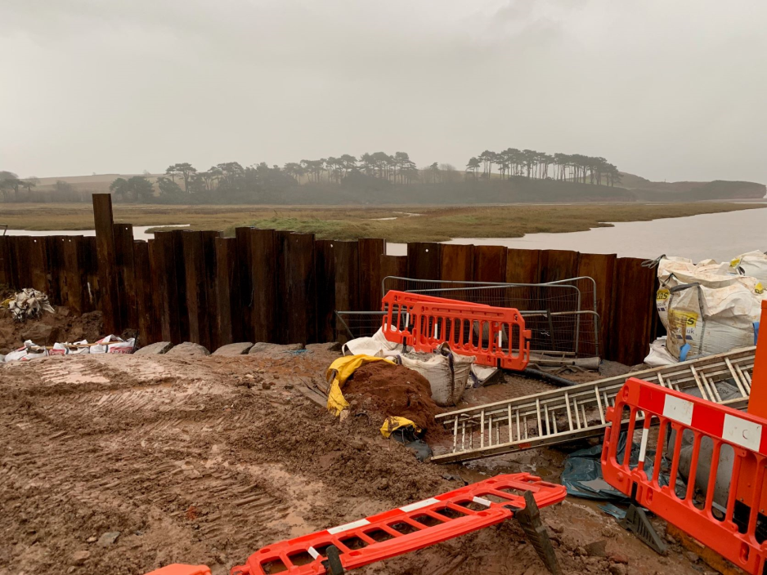
Landscape change – the river
In March 2018, flooding caused severe erosion of embankments built to protect agricultural land from flooding.
The photo below shows embankment repairs following the floods.

Slide 11
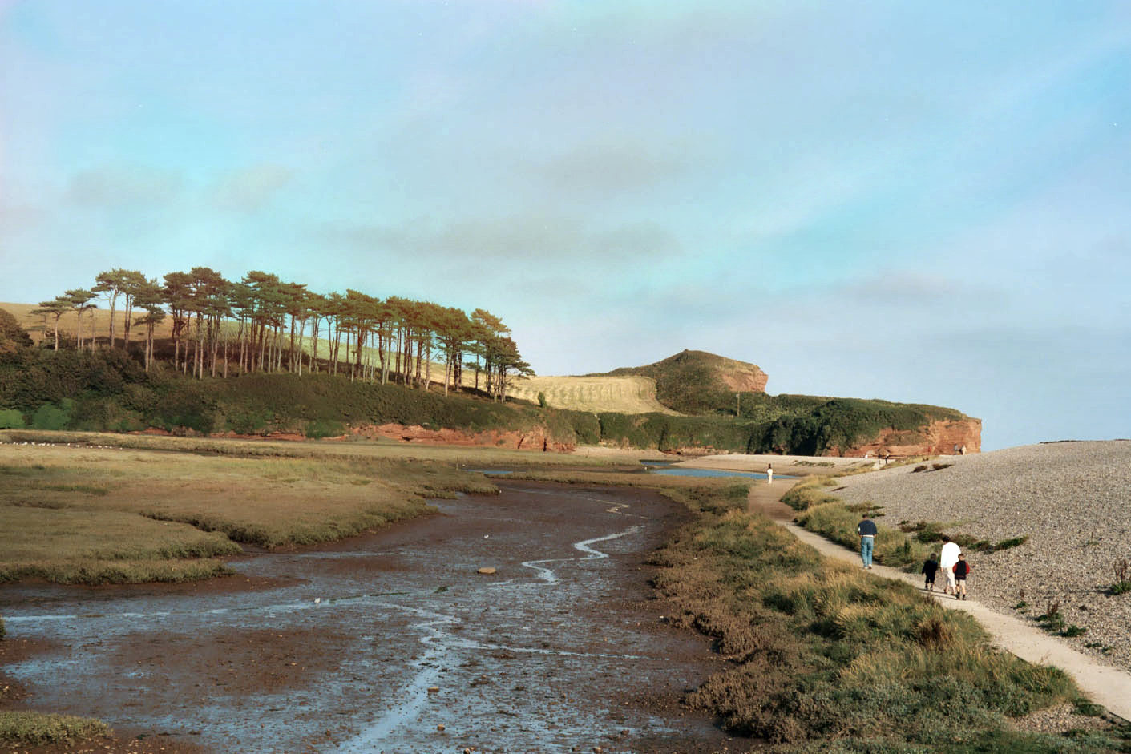
Landscape change – weather and climate
The Lower Otter Estuary is special.
It is an important natural habitat for breeding and wintering bird species
The area is enjoyed by tens of thousands of visitors each year
However, the estuary faces challenges due to climate change such as rising sea levels and more extreme rainfall events.
Erosion and overtopping of existing embankments
Impacts on local people and businesses if South Farm Road were to be flooded
Cricket club subject to more regular flooding
Impacts on farming and recreation (e.g. footpaths eroded or flooded)
River Otter
Sandstone cliffs
Shingle ridge
Saltmarsh and
mudflats
https://en.wikipedia.org/wiki/River_Otter,_Devon#/media/File:River_Otter_Devon.jpg

Slide 12
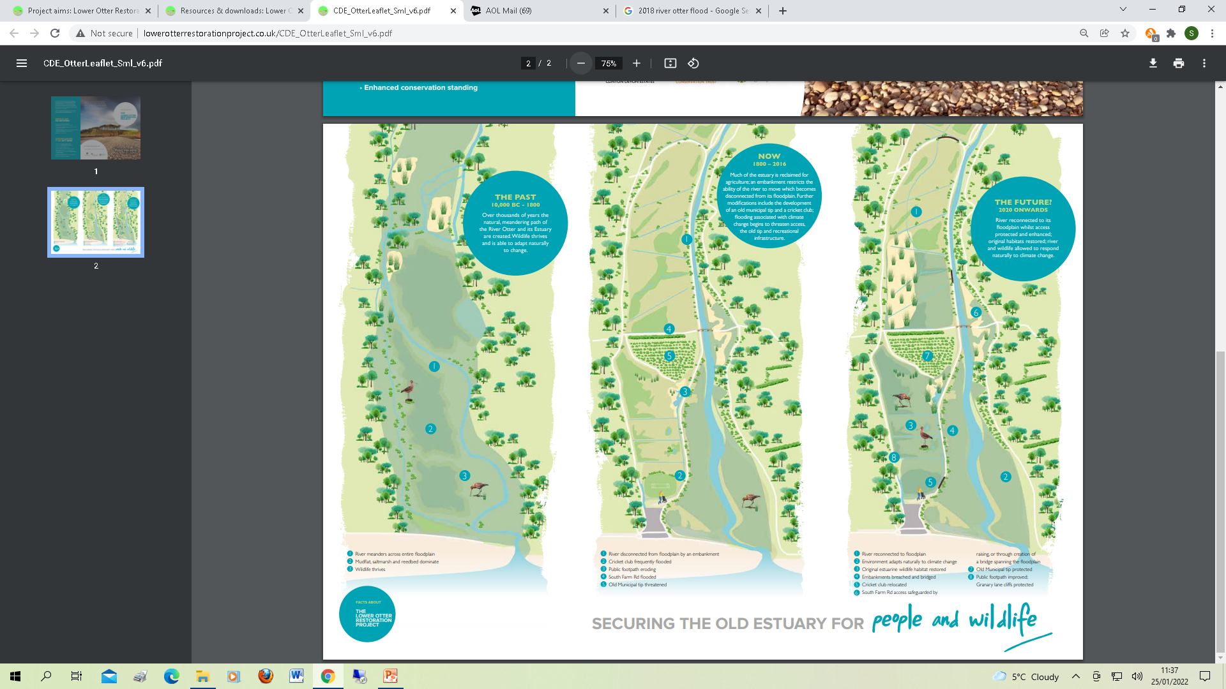
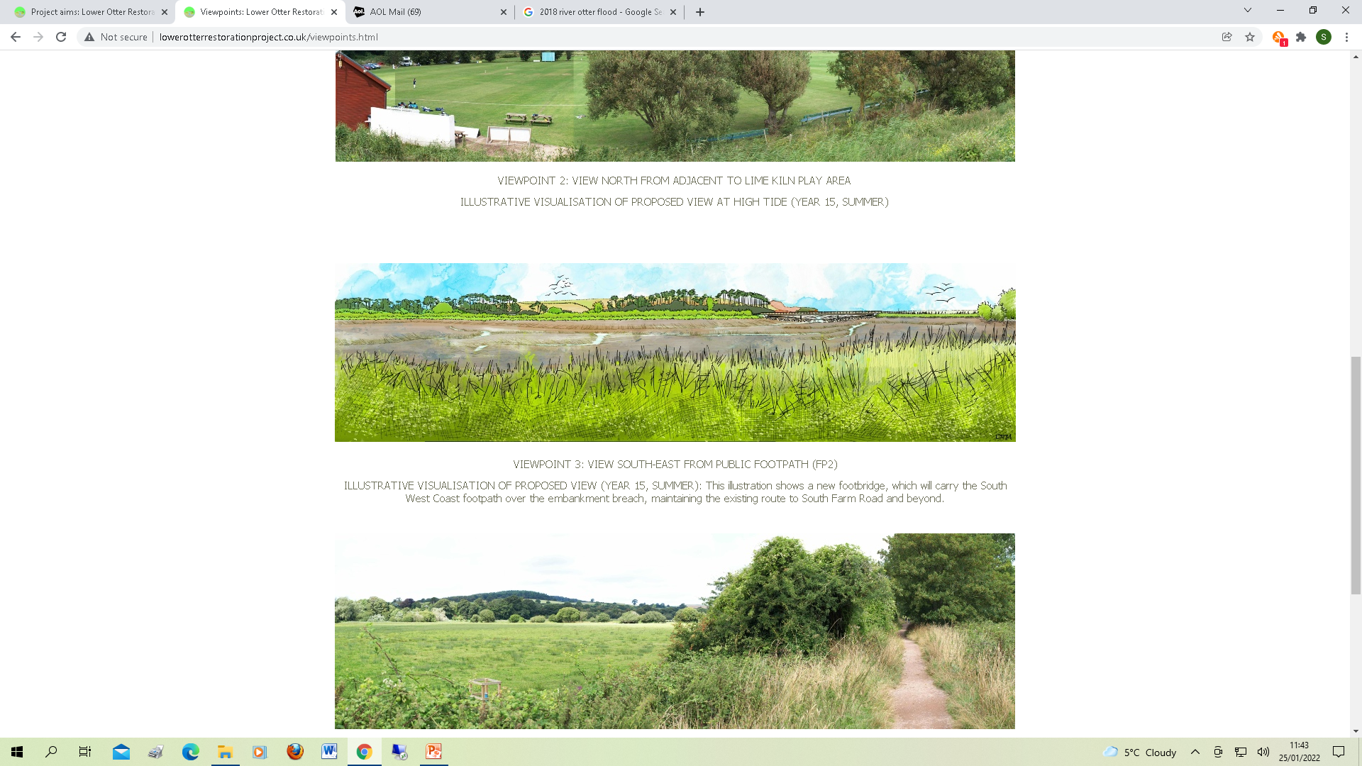
Landscape change – human activity
In the past, the River Otter would have meandered across its wide floodplain as it flowed towards the sea.
Much of the area would have been extensive tidal mudflats and saltmarshes, inundated by the sea at high tide
Occasional river floods would have washed silt (alluvium) across the floodplain and towards the sea
The area would have been a haven for wildlife particularly over-wintering birds
Trees would have grown on mounds of higher ground on the floodplain and much of the surrounding landscape would have been deciduous woodland

Slide 13
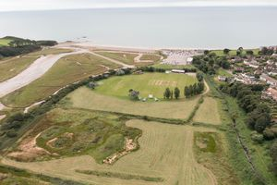
Landscape change – human activity
About 200 years ago, embankments were constructed to reclaim part of the floodplain for agriculture.
Some of the land has been used for recreation (e.g. the cricket club), for car parking and even a municipal rubbish tip!
Embankment
Car park
Cricket club

Slide 14
Landscape change – human activity
Embankments
All this is about to change!
The embankments are in need of repair and are in danger of being breached
With sea levels predicted to rise by up to 1m by 2100, the area is at increasing rise from seawater flooding.
Seawater flooding threatens to flood agricultural land, inundate roads and footpaths and flood trees and hedgerows on the floodplain.
In response to these issues, the Lower Otter is being restored to a more natural state, a sustainable solution to the issue of climate change.
Credit: KOR Communications

Slide 15
Landscape change – human activity
In 2023, the embankments will be deliberately breached to allow seawater to once again flood over the area.
The Lower Otter floodplain will be restored to its full width increasing its natural capacity for flooding at high tide.
River flooding (due to more extreme future rainfall events) will occur naturally across the original floodplain
Bridges, roads and footpaths will be raised to provide flood-free access for people
Wildlife will benefit from the creation of natural intertidal habitats
The landscape will be changed as the area is restored to its natural state.

Slide 16
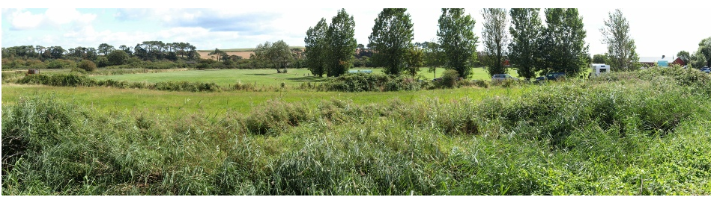
Landscape change – the final vision
The photograph is a view across the River Otter floodplain looking towards the south-east. It shows today’s landscape largely managed for farming.
The artist’s sketch below shows what the site might look like in the future (summer) after the embankments have been breached.
It shows extensive natural mudflats and saltmarsh with a new footbridge carrying the South West Coast Path over the embankment breach.

Slide 17
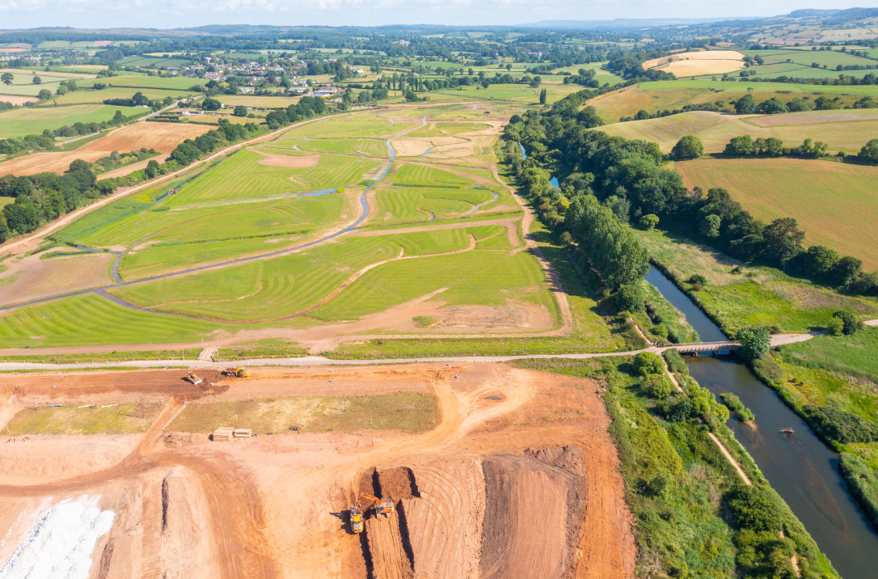
Landscape change – conclusion
The landscape of the Lower Otter has changed greatly over the centuries and will continue to change in the future.
Shaped by natural processes involving the sea, the river and the area’s weather and climate, perhaps the most influential factor affecting landscape change has been the actions of people.
Having once sought to control the area’s natural processes of river and coastal flooding, the future vision is one of restoring the Lower Otter to its largely natural state in response to the challenges of climate change.
Credit: KOR Communications

Slide 18
For more information visit www.pacco-interreg.com

