Slide 1
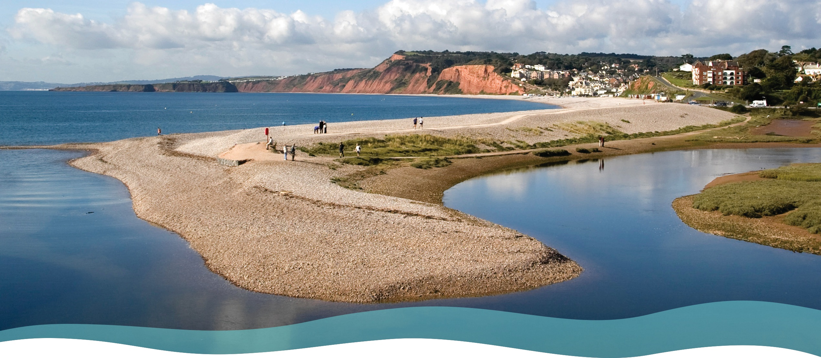

Managed coastal realignment
Lower Otter, Devon

Slide 2
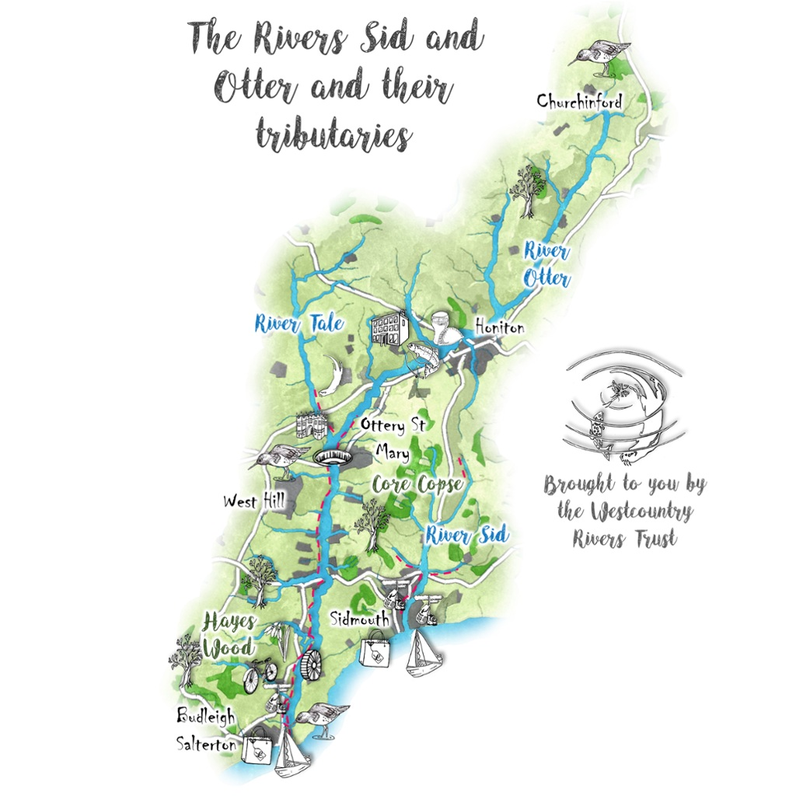
The River Otter, South Devon
The River Otter is a small river that flows from its source in the Blackdown Hills (Somerset) south to the English Channel coast at Budleigh Salterton (Devon).
The river’s length is 44km (27 miles).
The river flows through a rural farming landscape, with small cattle, sheep and dairy farms.
The Otter Estuary Nature Reserve is a Site of Special Scientific Interest (SSSI) consisting of saltmarsh and mudflats.
Once extinct, the River Otter is England’s only river with a breeding population of beavers.
https://wrt.org.uk/project/river-otter-sid/
https://www.freecountrymaps.com/map/towns/great_britain/117061762/

Slide 3
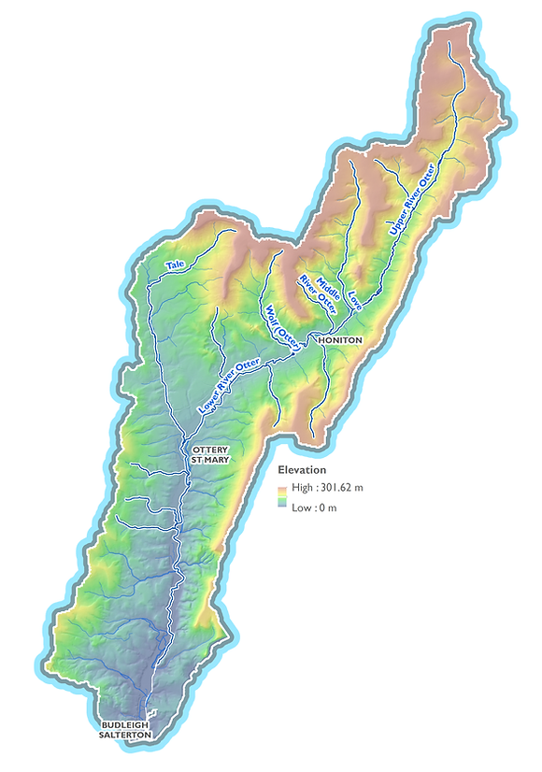
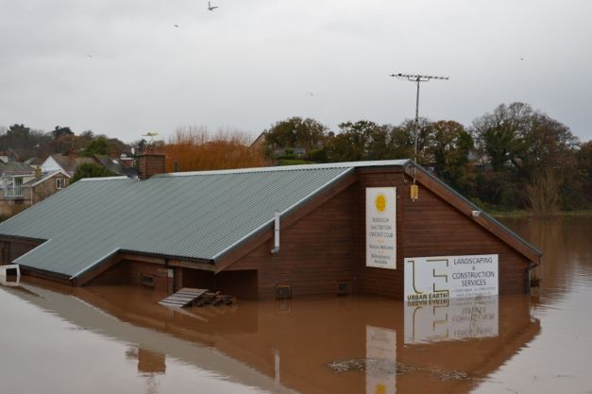
River Otter drainage basin
The River Otter drains an area of about 230 square km.
There is a high drainage density with many short tributaries joining the main river. This promotes rapid runoff and contributes to the risk of flooding.
Much of the Lower Otter valley is flat and low-lying. It is prone to flooding (2018, 2021) when extreme rainfall events trigger high runoff from the headwaters.
Budleigh Salterton
Cricket Clubhouse
(2018)
1 km
https://www.riverotterfisheriesassociation.org/maps-of-the-river-otter-catchment

Slide 4
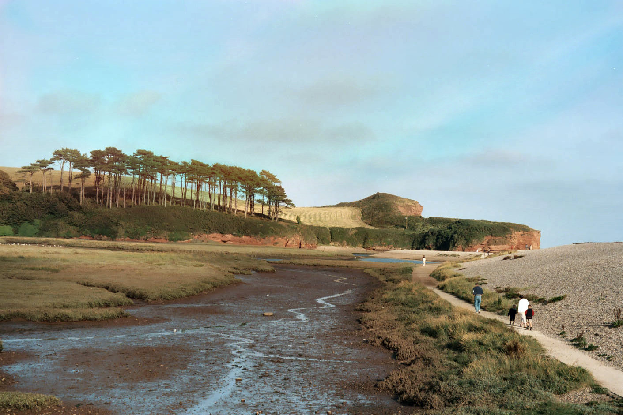
The Lower Otter estuary
The Lower Otter Estuary is a very special place.
It is home to local people and businesses.
It provides habitats for a wide variety of breeding and wintering bird species
It is enjoyed by tens of thousands of visitors each year.
However, the estuary faces growing challenges due to climate change such as rising sea levels and more extreme storms and rainfall events.
River Otter
Sandstone cliffs
Shingle ridge
Saltmarsh and mudflats
https://en.wikipedia.org/wiki/River_Otter,_Devon#/media/File:River_Otter_Devon.jpg

Slide 5
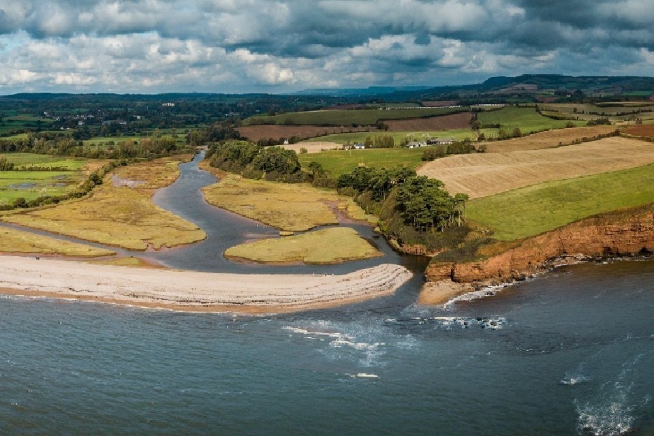
Adaptation to climate change: the issue
Two hundred years ago, embankments were constructed to reclaim land for agriculture.
The embankments (see photo) are no longer effective and are in danger of being breached. This was nearly the case in 2018, when the cost to repair them was vast.
With sea levels predicted to rise by over 1m in the next 100 years, the area is at increasing rise from seawater flooding.
Seawater flooding threatens to flood agricultural land, inundate roads and footpaths, and kill trees and hedgerows in the floodplain.
Embankments
Credit: KOR Communications
https://www.gov.uk/government/news/environment-agency-submits-final-plans-for-otter-valley-project

Slide 6
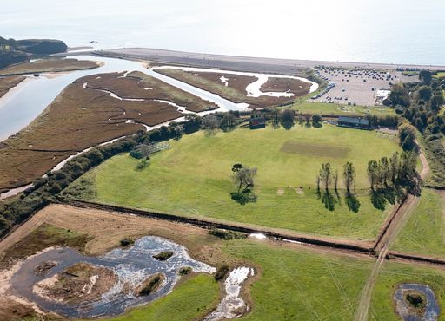
The need for a sustainable solution
Embankment
This photo looks south towards the English Channel. Budleigh Salterton is to the right.
The embankments (marked by a line of trees and hedges) split the floodplain into two.
To the left, the river meets the sea forming an estuary with mudflats and saltmarsh.
To the right, the land has been drained and improved for farming.
The embankments are no longer fit for purpose. Climate change means that a long-term sustainable solution is needed to manage this stretch of coastline and the Lower Otter floodplain.
Credit: KOR Communications

Slide 7
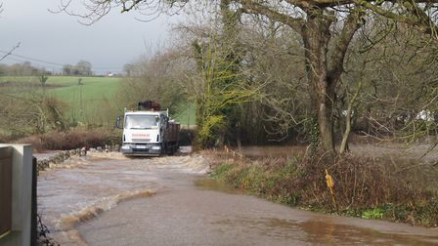
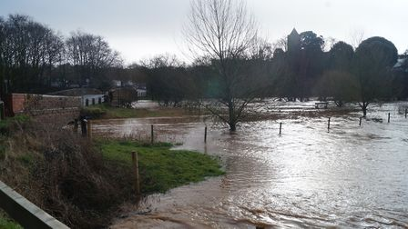
Flooding 2018 – a sign of things to come?
In March 2018, following a period of heavy rainfall, the River Otter burst its banks near Otterton.
Floodwaters surged across local roads disrupting transport communications in the area.
The River Otter floods most years often cutting off the village of Otterton.
The photo on the next slide shows the extent of flooding across the floodplain. Notice that the embankments are preventing water draining away at low tide!
In 2021, serious flooding caused road closures and inundated agricultural land.
https://www.exmouthjournal.co.uk/news/warning-to-motorists-as-roads-severely-flooded-near-exmouth-5780342

Slide 8
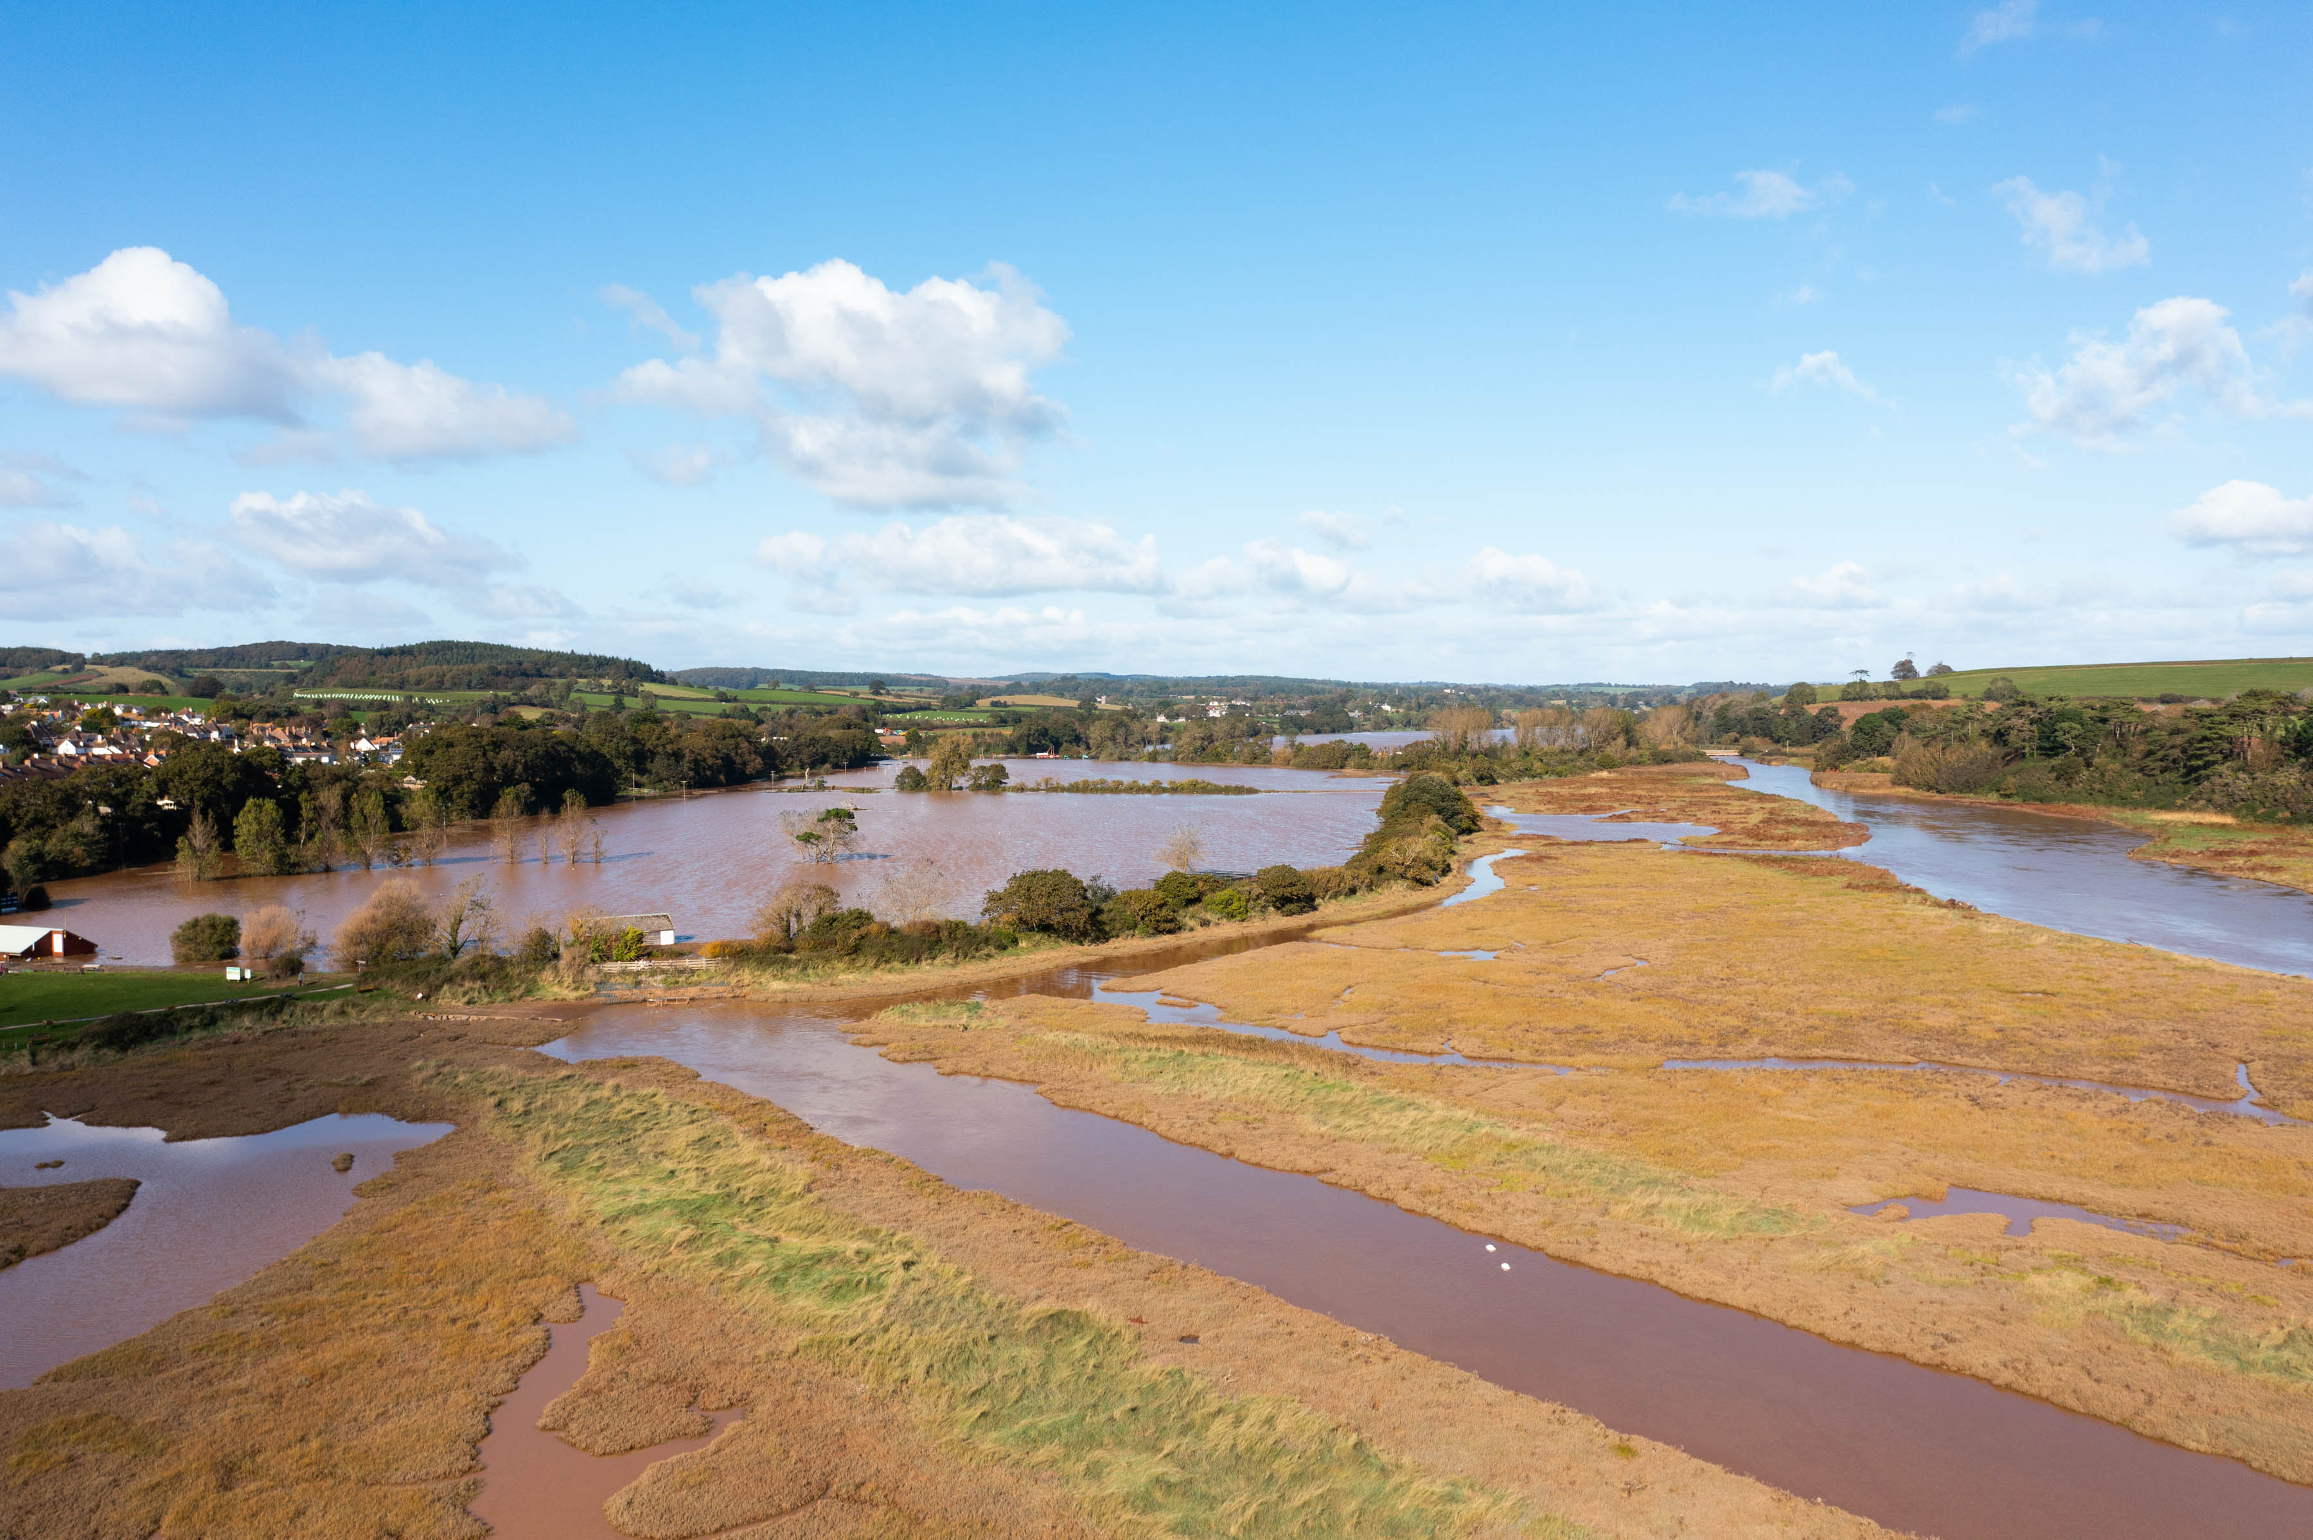
Credit: KOR Communications

Slide 9
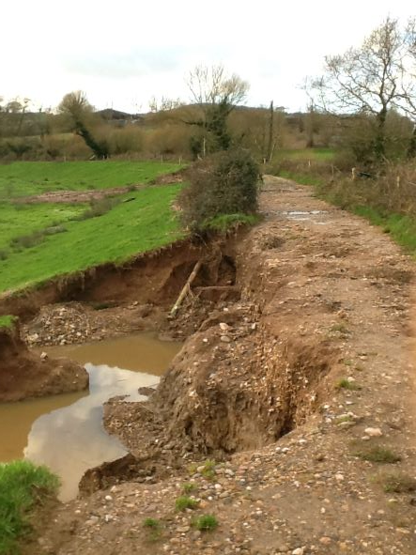
Flooding damage to embankments
In March 2018, floodwaters surged across the lower Otter floodplain lapping the embankments.
The photo shows damage caused by river erosion to Big Bank. Notice that part of the embankment has been completely washed away.
Further damage occurred during the 2021 floods.
With flooding likely to become more frequent and intense in the future, further embankment damage and breaching is inevitable.
This is a strong argument for adopting a more sustainable form of flood management.

Slide 10
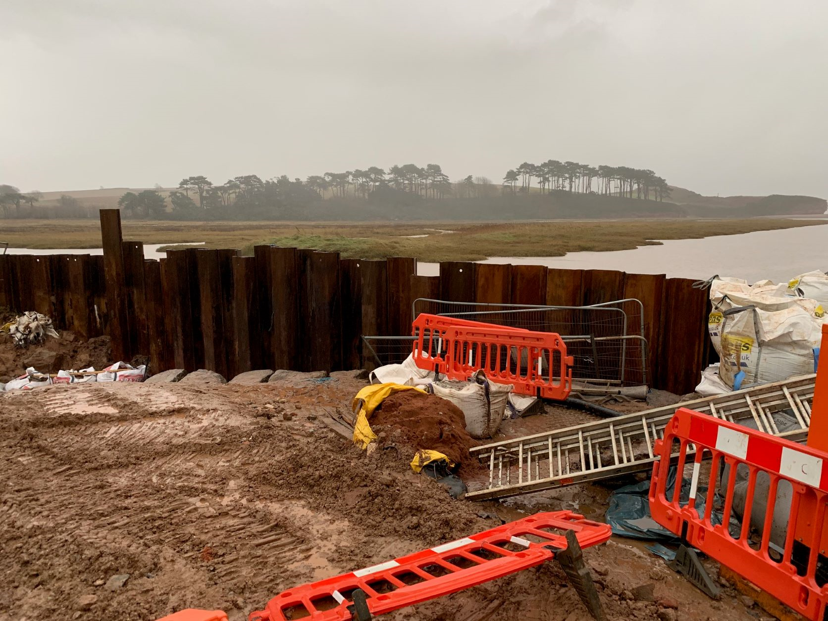
Embankment repairs following the 2018 flood

Slide 11
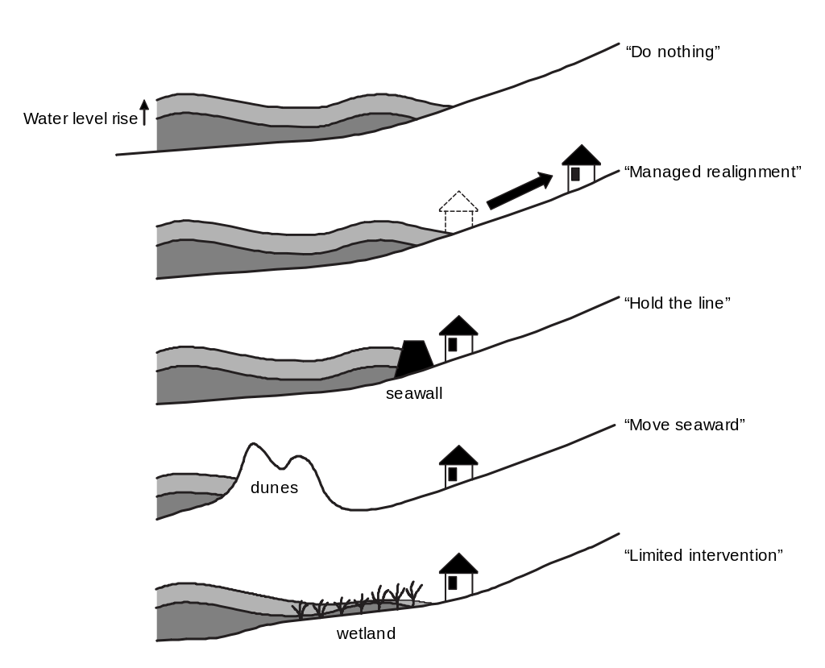
What are the generic options?
Do nothing – this involves . . . . doing nothing! The coastline is allowed to adapt naturally to the changing climate. Erosion and flooding will occur.
Managed realignment - the coastline is managed to adapt to new conditions. Property is relocated.
Hold the line - coastal defences such as sea walls ‘hold the line’ of the coast.
Move seaward - coastal management advances the coastline to provide enhanced protection of valuable land/property.
Limited intervention - reduces the impact of changing conditions.
https://en.wikipedia.org/wiki/Coastal_management#/media/File:Fivepolicies.svg

Slide 12
What were the options for the Lower Otter?
For the Lower Otter, three options were identified:
Do nothing – the embankments were constructed 200 years ago when the river was straightened. There is an increasing risk that they could fail leading to widespread flooding.
Hold the line – new defences are expensive to build and usually only appropriate when defending high value property
Managed realignment – working with natural processes, the shoreline and habitats are allowed to evolve naturally through careful management, securing the best possible benefits for people and wildlife
https://en.wikipedia.org/wiki/Coastal_management#/media/File:Fivepolicies.svg

Slide 13
What was the decision?
In 2012, the landowner Clinton Devon Estates and a broad range of stakeholders decided to tackle the long-term challenges associated with climate change.
In the period 2012-2015, the social and economic implications of the three options (‘Do Nothing’, ‘Hold the Line’ and ‘Managed realignment’) were considered. Detailed site investigations were conducted (flood risk, groundwater and landfill).
In 2015, the decision was made to adopt the managed realignment option:
Managed realignment is less costly than building new defences
‘Do nothing’ would create uncertainty and anxiety for local people who would simply have to wait for the embankments to fail
Managed realignment can safeguard and improve public access and wildlife habitats

Slide 14
Managed realignment – the outline plan
Controlled breaching of the old embankments will restore the floodplain of the River Otter.
The farmland and old Budleigh Salterton cricket ground will be allowed to flood at high tide. This land will transition to become important mudflats and saltmarsh for wading birds.
The Budleigh Salterton cricket ground will be relocated elsewhere and will no longer be threatened by flooding.
The total cost is estimated to be £12m. £8.5m will come from the European Interreg France (Channel) England Programme. Other funding will come from the Environment Agency and Clinton Devon Estates which owns the land.

Slide 15
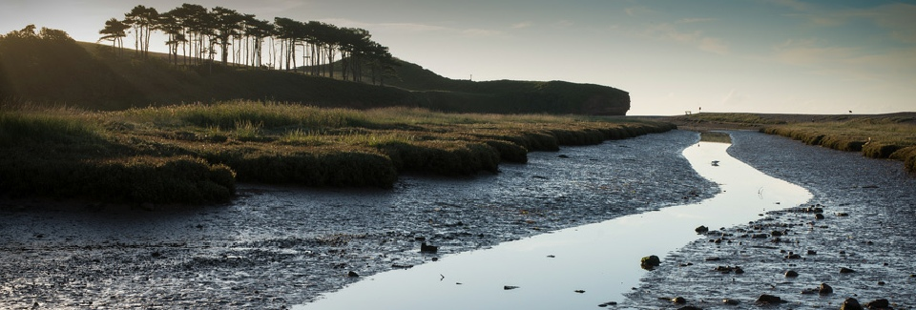
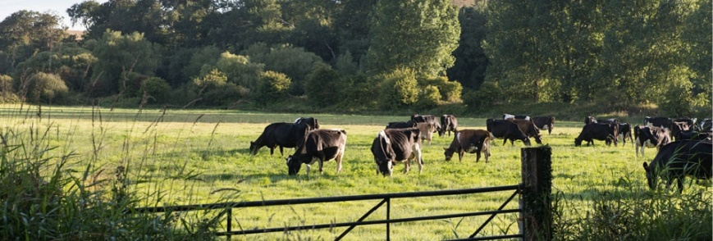
Managed realignment – the aims
Stabilising the former domestic refuse tip to protect against future erosion.
Working with Budleigh Salterton Cricket Club to find a more sustainable site which is less prone to flooding.
Provision of new education and interpretation facilities.
An increased area of rare inter-tidal habitats with significant biodiversity benefits, including for birdlife.
Working with tenant farmers to adjust existing land use, allowing livelihoods to be secured, water quality to improve and biodiversity to increase.
Maintain and secure existing public footpaths. including part of the nationally important South West Coast Path (via the footbridge over the breach).
Secure vehicle access for local residents and businesses, by raising roads or bridges.
Reconnecting the river to its floodplain, allowing it to flood and drain naturally by breaching the embankments.
Bridges spanning the breaches will allow continued public access.

Slide 16
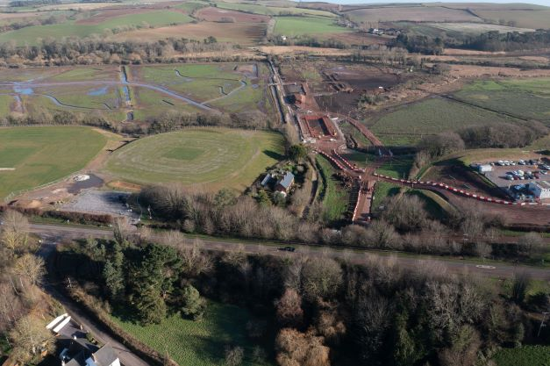
Managed realignment – the timeline
2021
Clearance of vegetation
Construction of new bridge foundations, road embankments and footpath raising
2022
Completion and surfacing of roads, bridges and footpaths
Diversion of services (water, electricity, sewage)
Removal of cricket club
2023
Completion of old landfill cover
Controlled breaching of embankments
Landscaping

Slide 17
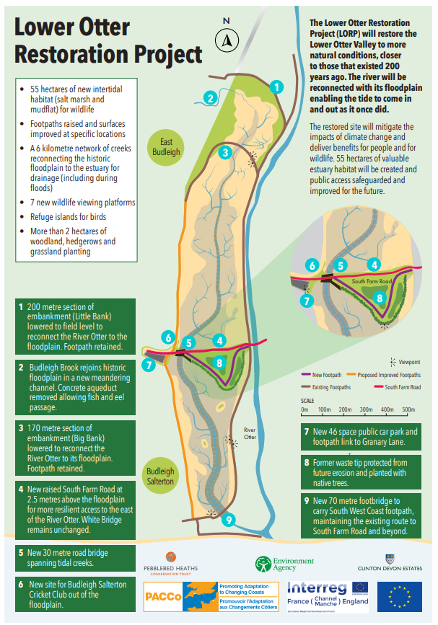
Managed realignment – actions
The map alongside illustrates some of the actions and works that form part of the realignment project. Notice:
The lower Otter floodplain will be restored to its full width increasing its natural capacity for flooding at high tide.
River flooding (due to more extreme future rainfall events) is accommodated to prevent it ponding-up behind embankments.
Raising of bridges, roads and footpaths to protect from flooding.
Benefits to wildlife by the creation of intertidal habitats

Slide 18
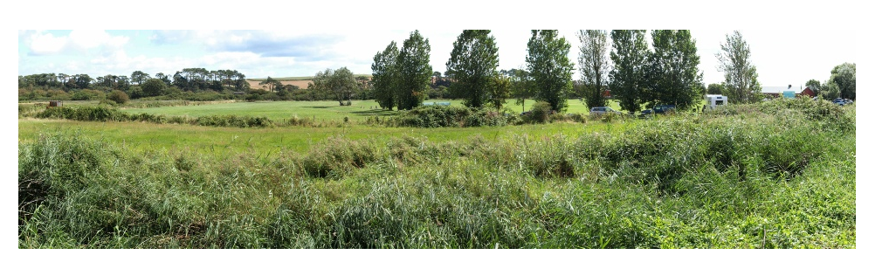
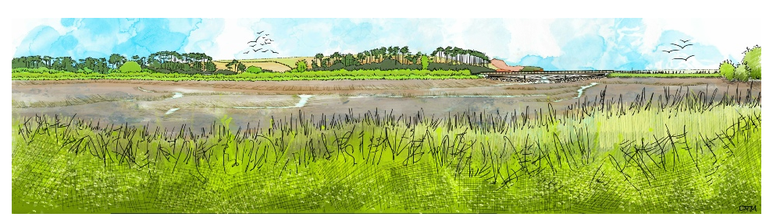
Managed realignment – the vision
The photograph is a view across the River Otter floodplain looking towards the south-east.
The artist’s sketch visualises the view in years to come after the breach.
It shows mudflats and saltmarsh with a new footbridge carrying the South West Coast Path over the embankment Breach.
The next slide illustrates the evolution of the Lower Otter and shows how coastal realignment restores the natural floodplain.

Slide 19
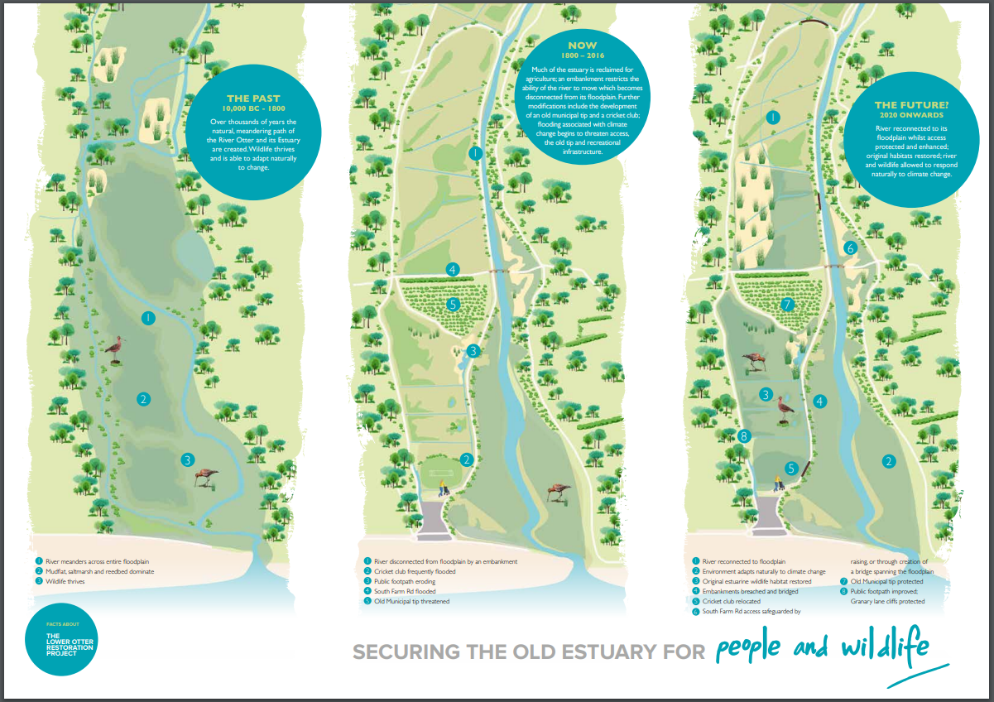

Slide 20
Managed realignment – costs and benefits
Costs
The total cost is £12m of which £8.5m is European funded
Relocation of Budleigh Salterton cricket ground
Loss of farmland currently used for grazing
Disruption to local people and businesses during construction (roads, bridges, etc)
Remedial action required to secure old landfill site and prevent future contamination
Disruption to walkers caused by closure and re-routing of footpaths during works.
Benefits
Creation of natural habitats (mudflats, saltmarsh, reedbeds) which will increase biodiversity and provide nesting and over-wintering grounds for birds
Sustainable management of the floodplain to address climate change (higher sea levels, increased storminess and higher rainfall events)
Increased resilience to flooding of infrastructure (e.g. raising roads, bridges and footpaths)
Relocation of Budleigh Salterton cricket club to non-flood prone location
Increased amenity value particularly during the winter ‘off-season’ months by attracting birders and thereby boosting the local economy.

Slide 21
For more information visit www.pacco-interreg.com

